Slide 1
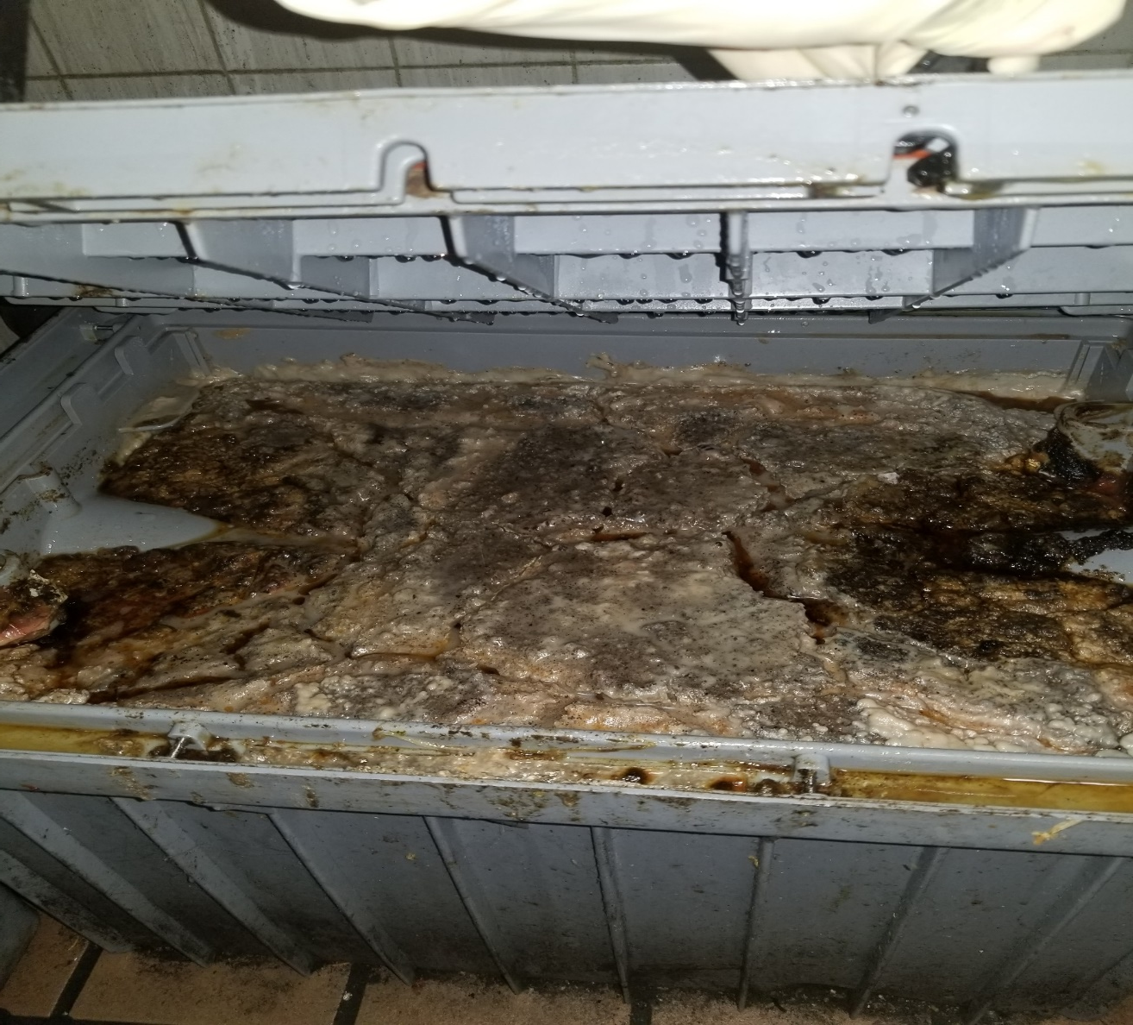
FOG 101 & One Water

Slide 2

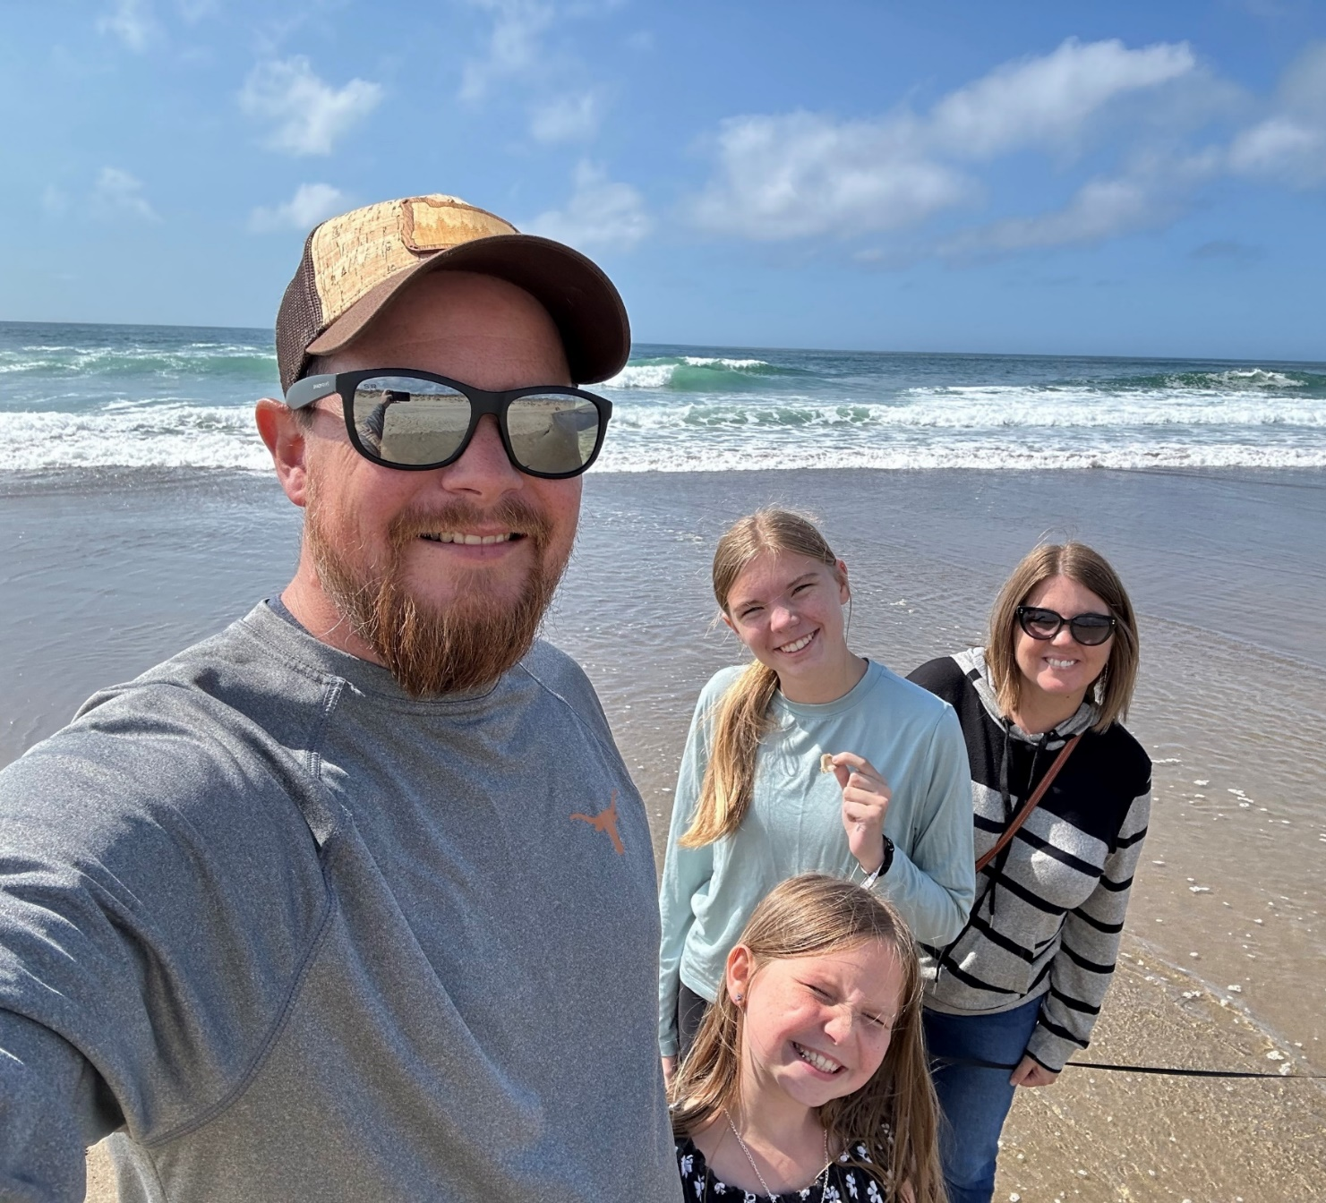
Destin Ranch
City of Eugene, Environmental Compliance Specialist
Dranch@Eugene-or.gov
541-870-4001

Slide 3
Agenda
What are the basics of a functioning FOG program?
General Inspection Overview.
What does One Water have to do with FOG?

Slide 4
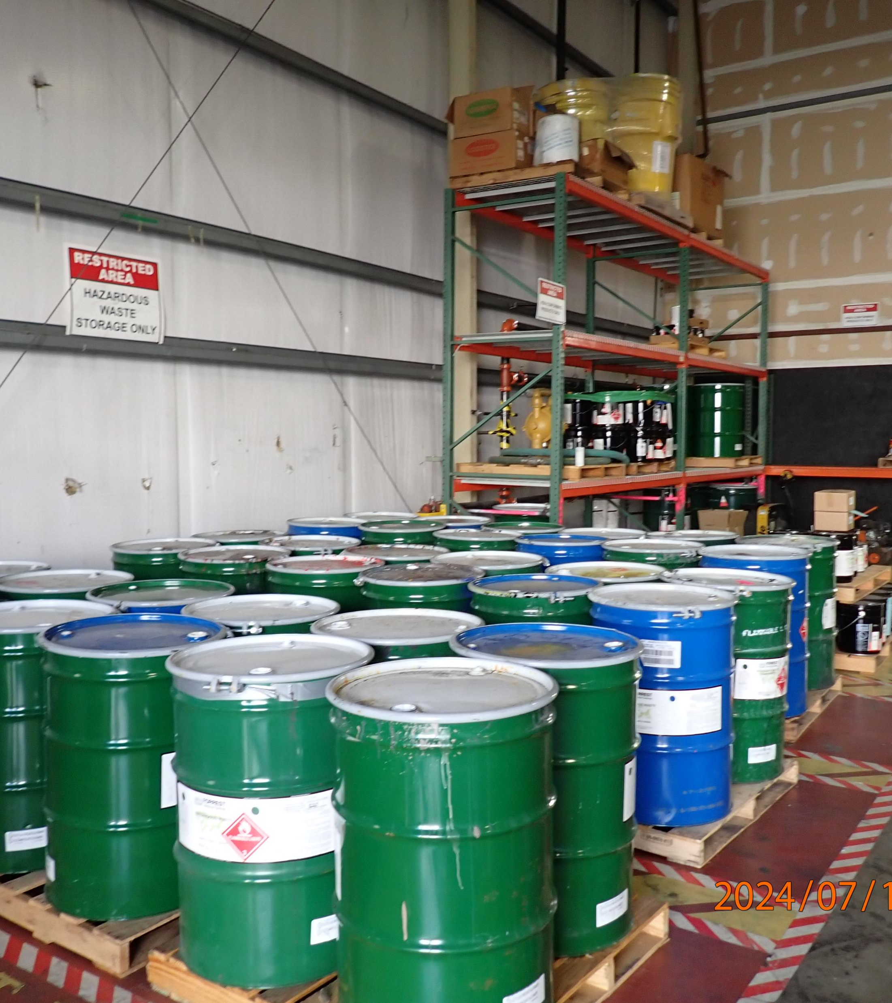
Who is City of Eugene’s Regulatory Services Program?
Oversee industrial users (IU’s) who discharge wastewater to the POTW (Publicly Owned Treatment Works)
Issue Wastewater Discharge Permits to IU’s
Currently Regulatory Services oversees 16 CIU/SIU’s and 10 NDCIU’s
16 Permitted Mobile Waste Haulers who discharge at POTW
Oversees multiple Sector Control Programs including: Fermenters (Breweries, wineries, distilleries, etc.), Dental, Laboratories, Photo Developers, etc..
Regulatory Services Inspectors are also 1200-Z Agents
Implementing Commercial Automotive Stormwater Program

Slide 5
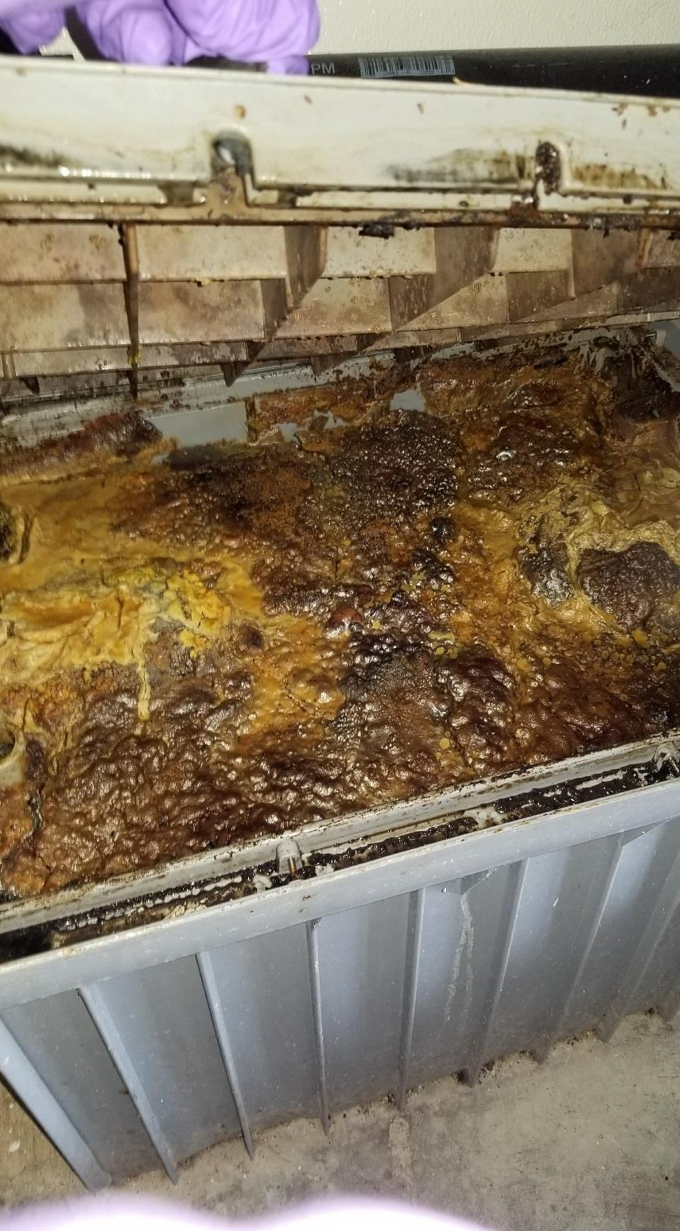
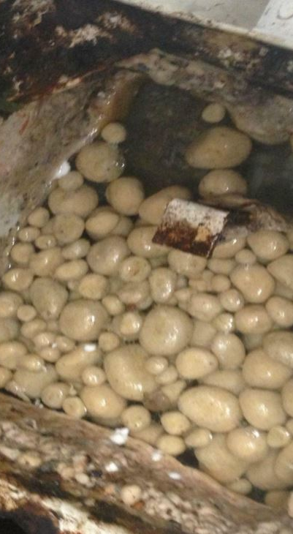
The FOG Program
Currently there are almost 900 FSE’s in our program
Notes:
This includes MFU’S. We do not have a FOG Ordinance. We recently approved a new Sector Control Program –Discharge Authorization Letter that serves as our FOG Control Document.

Slide 6
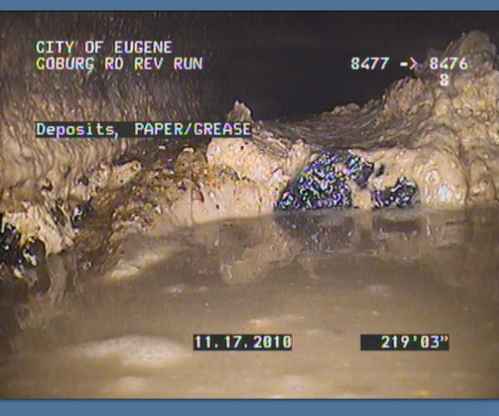
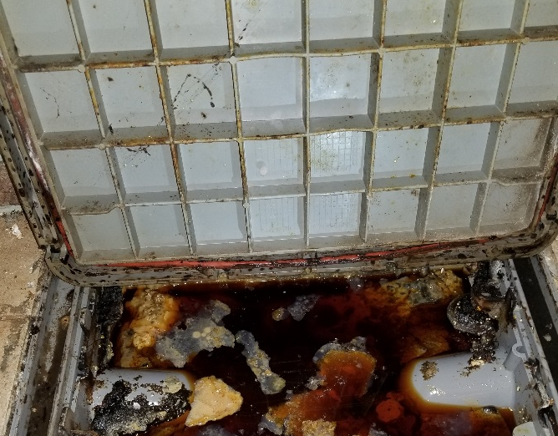
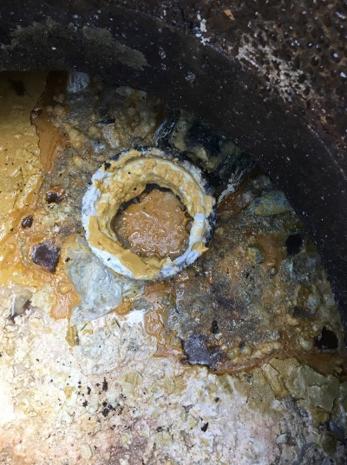
Why have a FOG program?
When FOG enters the sewer, it solidifies and combines with rags and other paper products to cause flow restrictions or sanitary sewer overflows (SSO)
Capacity, Management, Operations and Maintenance (CMOM) Program drive the necessity of having a FOG program
Notes:
What is CMOM? CMOM stands for "capacity, management, operations, and maintenance." It is a flexible, dynamic framework for municipalities to identify and incorporate widely-accepted wastewater industry practices to: • Better manage, operate, and maintain collection systems • Investigate capacity constrained areas of the collection system • Respond to sanitary sewer overflow (SSO) events The CMOM approach helps municipal wastewater utility operators provide a high level of service to customers and reduce regulatory noncompliance. CMOM can help utilities optimize use of human and material resources by shifting maintenance activities from “reactive” to “predictive”–often leading to cost savings through avoided overtime, emergency construction costs, increased insurance premiums, and the possibility of lawsuits.

Slide 7
In accordance with the regulatory framework of the Clean Water Act, the City of Eugene’s Pretreatment program has the following goals:
Preventing pollutants entering the system that will compromise the collection system or the Publicly Owned Treatment Works (POTW)
Prevent pollutants from entering the system that will not be adequately treated and thus will be discharged to the receiving water of the POTW
Requiring and policing businesses in industries known for discharging large amounts of FOG (restaurants and industrial food preparation facilities) to have collection grease interceptor that prevent FOG from entering the conveyance system.
Ensure that the pre-treatment devices must be regularly serviced so they do not fail and discharge FOG to the collection system.
Notes:
This language comes directly from our Capacity, Management, Operations, & Maintenance Plan (CMOM). The program is adopted through city code and Sewer Use Ordinance which includes compliance requirements imposed under the FOG Reduction Program which requires that a food service establishment to install an appropriate grease interceptor, adequately maintain the grease interceptor to prevent the discharge of FOG and maintain a record of cleaning/maintenance activities. Food service establishments that fail to comply with Pollution Management Practices are subject to enforcement. – Pg 25 of CMOM

Slide 8
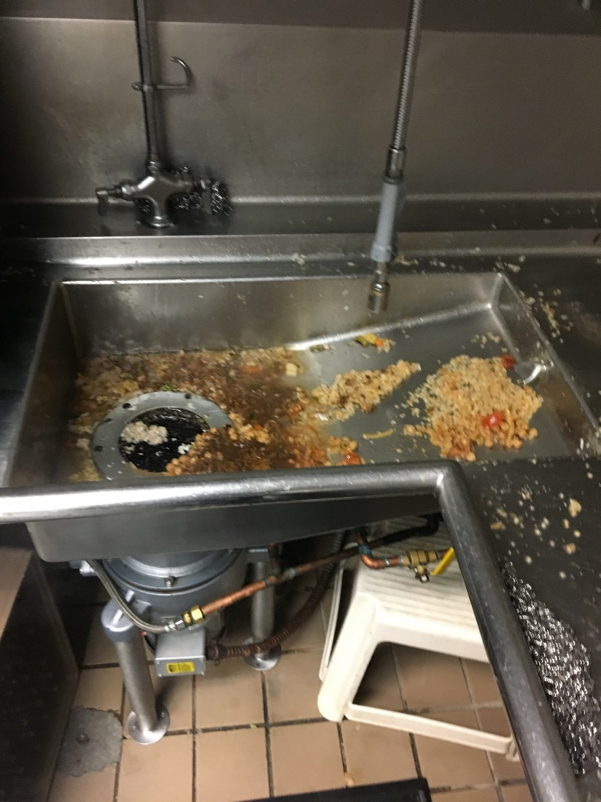
FOG happens in all steps of a kitchen not just deep frying.
Oregon plumbing code requires all FSE kitchen fixtures, including floor drains be plumbed to a grease interceptor (GI) to ensure all FOG is captured on-site.
Butter, cream, animal fats, oils, yogurt, avocado, dressing, marinade, dough, sauce, etc. all contains some FOG
Notes:
The common misconception is that if there is no oil fryer, there is no FOG, this is completely false. If it sticks to your plate, it will stick to your pipes! When going into a kitchen it is important to find all sinks and fixtures to see if there is evidence of food products in them.
Note- The FSE is subject to the plumbing code at time of installation or when they opened. So if an FSE has been in business for 20 years and hasn’t done any major plumbing upgrades they still fall under the plumbing code from 20 years ago.
The most common statement I get when showing up for the first time at an FSE is “We don’t have any grease so we don’t need to be in the program” false.

Slide 9
Do the thing- Ask the questions!
Does this facility discharge FOG in their wastewater?
Do they have a GI?
Is it installed correctly?
How many fixtures are connected? Not connected?
When was it cleaned last?
How full is it?
FOG produced Level? (low, med, high)
Is the cleaning frequency adequate?
Is there a garbage grinder?
Where are grill hood filters &/or floor mats cleaned?
How is used cooking oil disposed of?
Is rendering bin and dumpster areas clean? Signs of spills?
Does the stormwater catch basin have signs of FOG?
Is the FSE contributing to a known FOG hotspot?
Is the FSE set up in SwiftComply?
Notes:
These are all the questions in our FOG inspection form. We also have lots of opportunities to add pictures as we go. Some of these questions lead to more questions depending on the answer. And they all lead to the post inspection conversation where the real work happens.

Slide 10
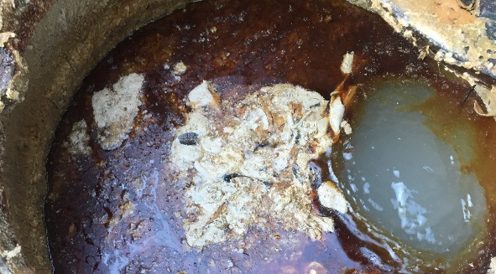
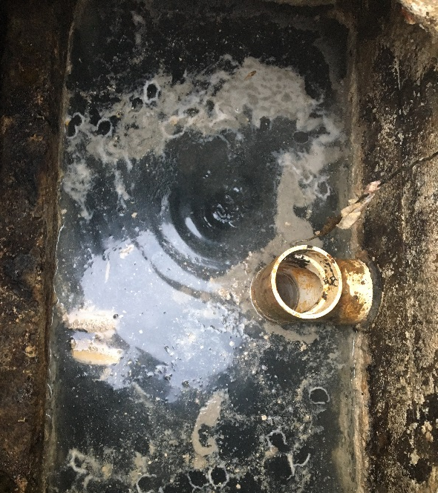
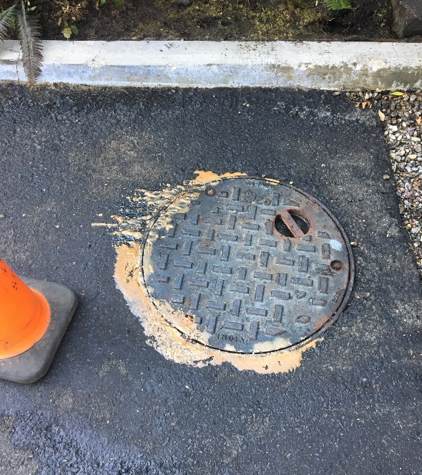
The City of Eugene uses the following criteria when inspecting a GI for compliance:
Hydro-mechanical Grease Interceptors:
<50% FOG and food solids accumulation=Compliant
>50% FOG and food solids accumulation =Violation
Gravity Grease Interceptors:
<25% FOG and food solids accumulation = Compliant
>25% FOG and food solids accumulation = Violation
*Unless specified by manufacturer
Waste removed from a GI shall be disposed of at a facility permitted to receive such wastes. Waste material removed from GI(s) shall not be disposed of directly or indirectly into any portion of the sanitary sewer system, private sewer line, stormwater system, or returned to any GI.
Notes:
We stole these criteria from the City of Bend (shamelessly), You will see other items in our program that we have pilfered from all over the country, why reinvent the wheel right?! Virginia Beach Virginia, City of the Dalles, and soon City of Olympia (LOTT) who has a really awesome FOG inspection SOP that I will steal from!
Failure to clean GI’s frequently enough can quickly cause back-up’s into the FSE causing them to have to shutdown and clean, on top of large plumbing bills. Additionally, making sure each GI has all the right parts and pieces to function properly.

Slide 11
What are the Best Management Practices for Food Service Establishments?
Inspect and maintain all GI’s regularly, as required by manufacturer.
Clean hood filters, floor mats and other equipment in an area (sink, floor drain, etc) that flows through GI. Do not dump wash water outside - only rain down the storm drain.
Ensure all sinks have drain screens installed prior to use.
Scrape dishes, pots, and pans thoroughly into trash or compost bin. Pre-rinse only after scraping – using low flow pre-rinse spray valves.
Never pour oil down the drain. Only use secure, covered, tip resistant oil rendering containers. Close covers and clean up spills. Never wash spills into the storm drain.
Clean around outside trash bins and oil rendering containers daily. Soak up spills, secure lids and sweep around trash and oils bins. Keep spills and trash out of the storm drain.
Use of additives (including but not limited to, products that contain solvents, emulsifiers, surfactants, caustics, acids, enzymes or bacteria) by FSEs is prohibited as a grease management control.
Notes:
These required BMPs are included in our Sector Control Program Document that was issued to all FSE’s on 4/21/25. Notice, this also addresses stormwater concerns.

Slide 12
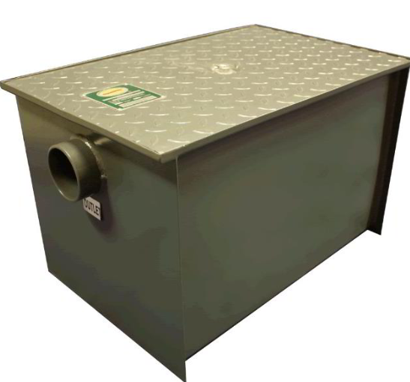
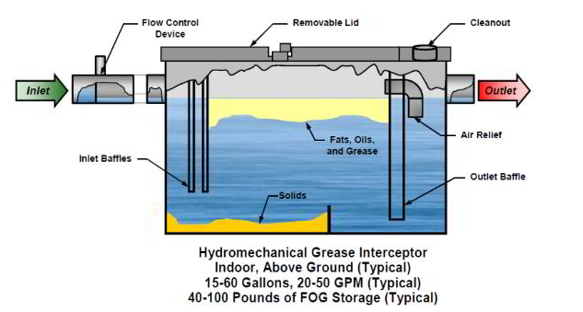
Types of Hydromechanical Grease Interceptors (HGI)
HGI Cutout
Atlanta Metal Works GI
Notes:
Metal box of disappointment due to corrosion and difficulty to maintain. Normal 20gal size can hold around 40-50lbs of grease, for some FSE’s this could mean cleaning weekly not every 3 months.

Slide 13
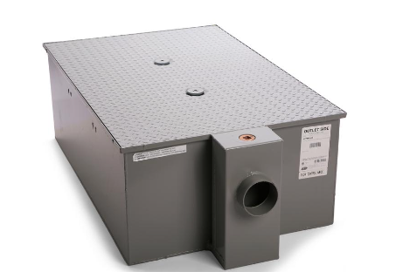
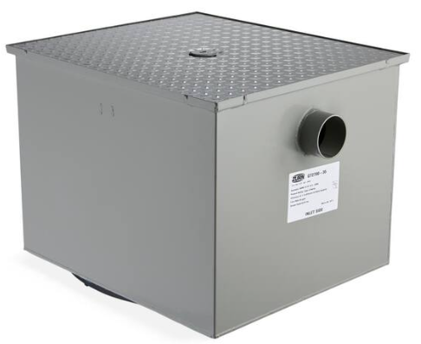
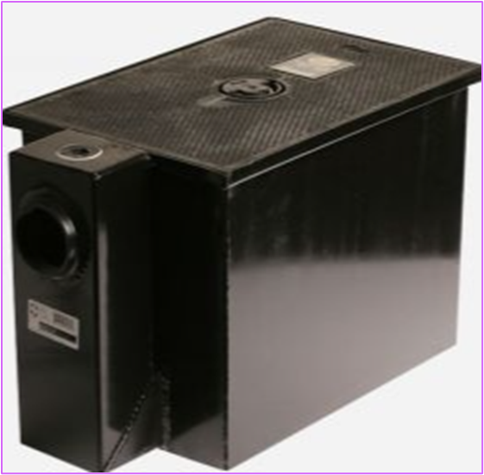
Metal Grease Interceptors
Zurn Low Profile
Zurn – Standard Smith 8020
Notes:
Metal Boxes of disappointment – Very efficient units, work great as long as they are maintained regularly (which they never are). As soon as the coating gets nicked or scratched corrosion sets in rapidly. Usually good

Slide 14
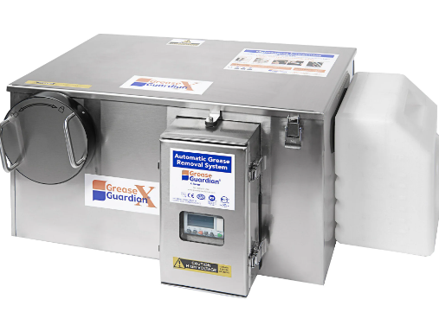
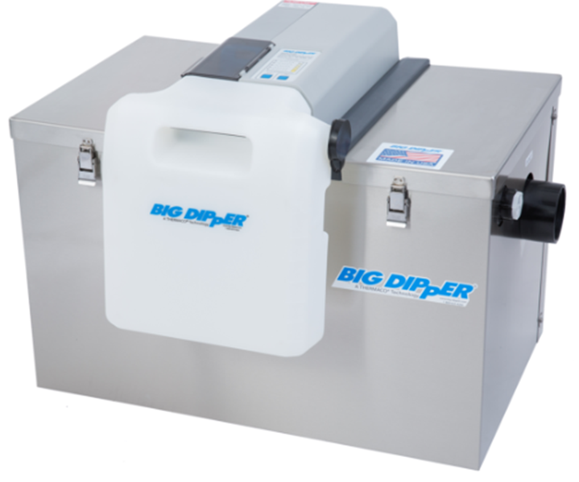
Automatic Grease Removal Device(s)
X15 Grease Guardian Big Dipper 35 GPM
Notes:
Automatic Grease Removal Device – may need to be monitored weekly or more depending on usage. I have only seen one of these in the wild.

Slide 15
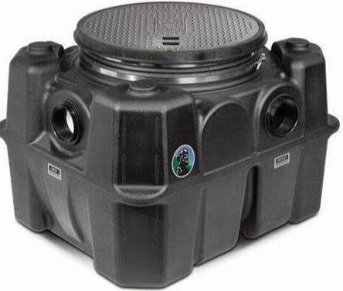
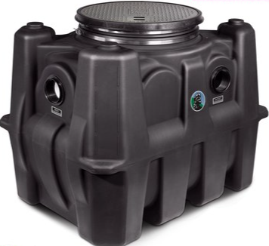
Plastic Grease Interceptors
Schier GB-50
Schier GB-75
Notes:
GB series very common, will only see the lid in ground either inside or outside. GB-50 hold 65gal of liquid and up to 439lbs of grease. GB-75 holds 125gal liquid and up to 861lbs of grease. Generally, FSE’s that have these units can go 3 months in between cleanings.

Slide 16
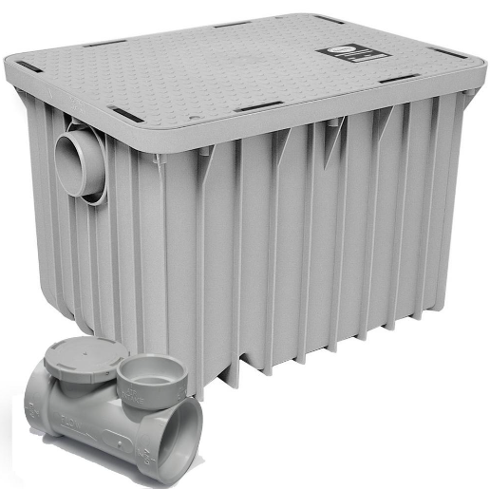
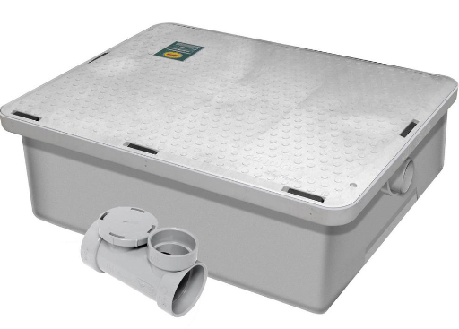
Plastic Grease Interceptors
Endura / Canplas 20GPM
Endura / Canplas Low Profile
Notes:
Most common units in our city by far. Very efficient units but often undersized for the restaurants wanting to clean every 3 months. Most should be cleaned every 2 weeks or more depending on the situation.

Slide 17
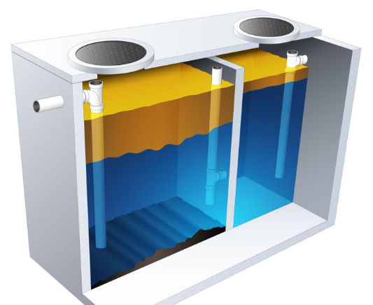
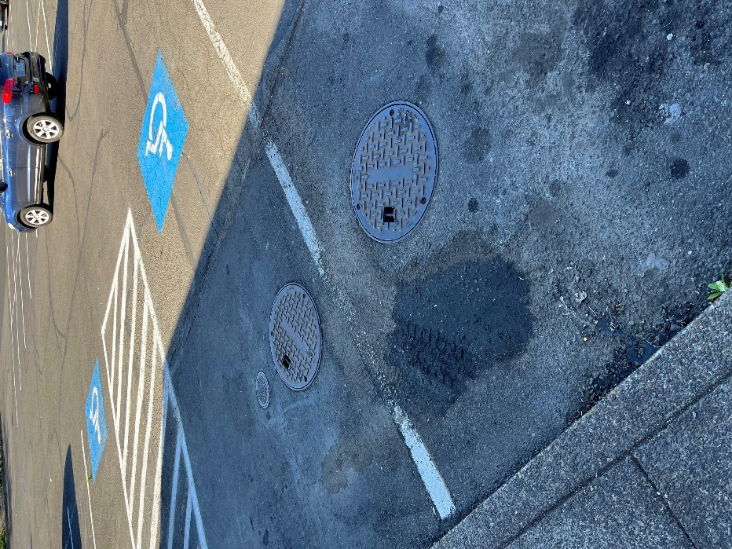
Gravity Grease Interceptor (GGI)
Notes:
Can be anywhere from 700-4500 gallons. Always outside, baffles can break during cleanings. Must be cleaned by licensed hauler with a vactor truck.
25% rule, measured using sludge measuring device or core sampler
See City of Olympia Wa- LOTT for a detailed list of Inspection Tools and set ups. I will be looking to incorporate their FOG Inspection SOP as it is really well put together!

Slide 18
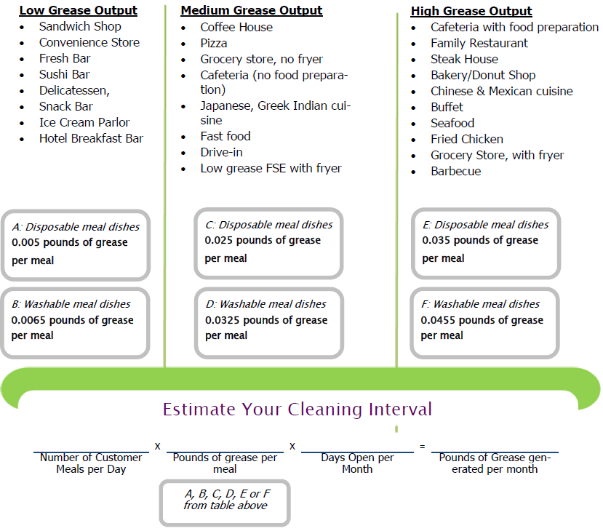
Grease Calculator
Credit: Jill Hoyenga - City of The Dalles
Great tool for getting FSE’s to understand how much FOG they produce
Electronic version is helpful
Notes:
Jill Hoyenga graciously shared this with us and did all the work to have the State Plumbing Program Chief, Andy Skinner review and approve it for FOG program usage.

Slide 19
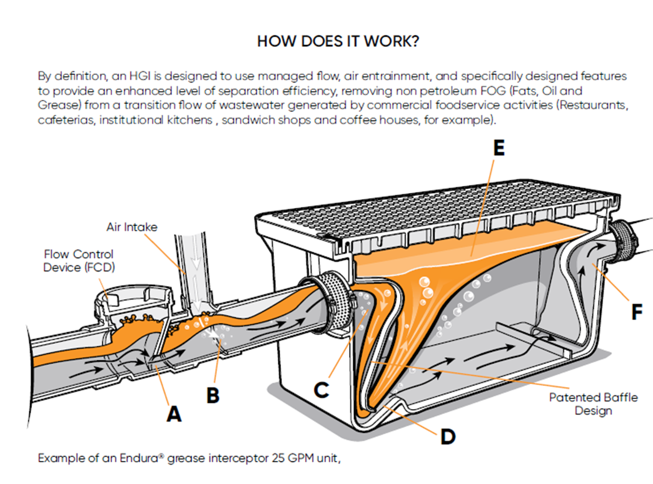
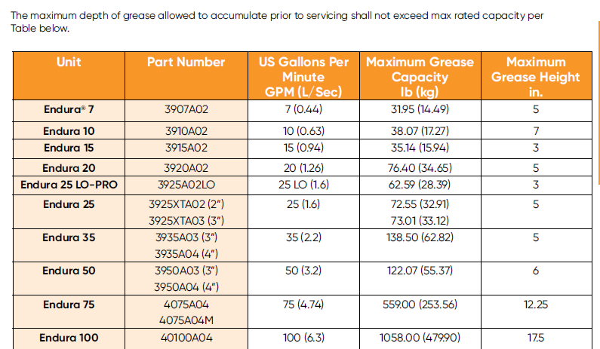
Endura cleaning frequency example
Notes:
The cleaning frequency of cleaning is dependent upon a variety of factors; the type of food served, the capacity of the
grease interceptor and the concentration of grease in the water. Increasing the frequency of cleaning will reduce odor
problems associated with grease interceptors and improve retention efficiency.

Slide 20
Common Findings in FOG Hotspots
The pre-rinse sink is not connected to a GI
Hood Vent Filters cleaned in unprotected sink regularly
Garbage grinder not connected to GI
GI connected to unused three compartment sink
Notes:
These are just a few things that can lead to Hotspots and or Sanitary Sewer Overflows (SSO) which the FOG program is implemented to prevent for the sake of human health, safety and protection.
More than likely, the FSE(s) have small GI’s that only get cleaned whenever their plumbing plugs up. There is also the mop sink and floor drains being used for waste disposal. Once our subsurface crews identify a FOG problem in our system, our FOG program gets a lot stronger with what we can do about it.

Slide 21
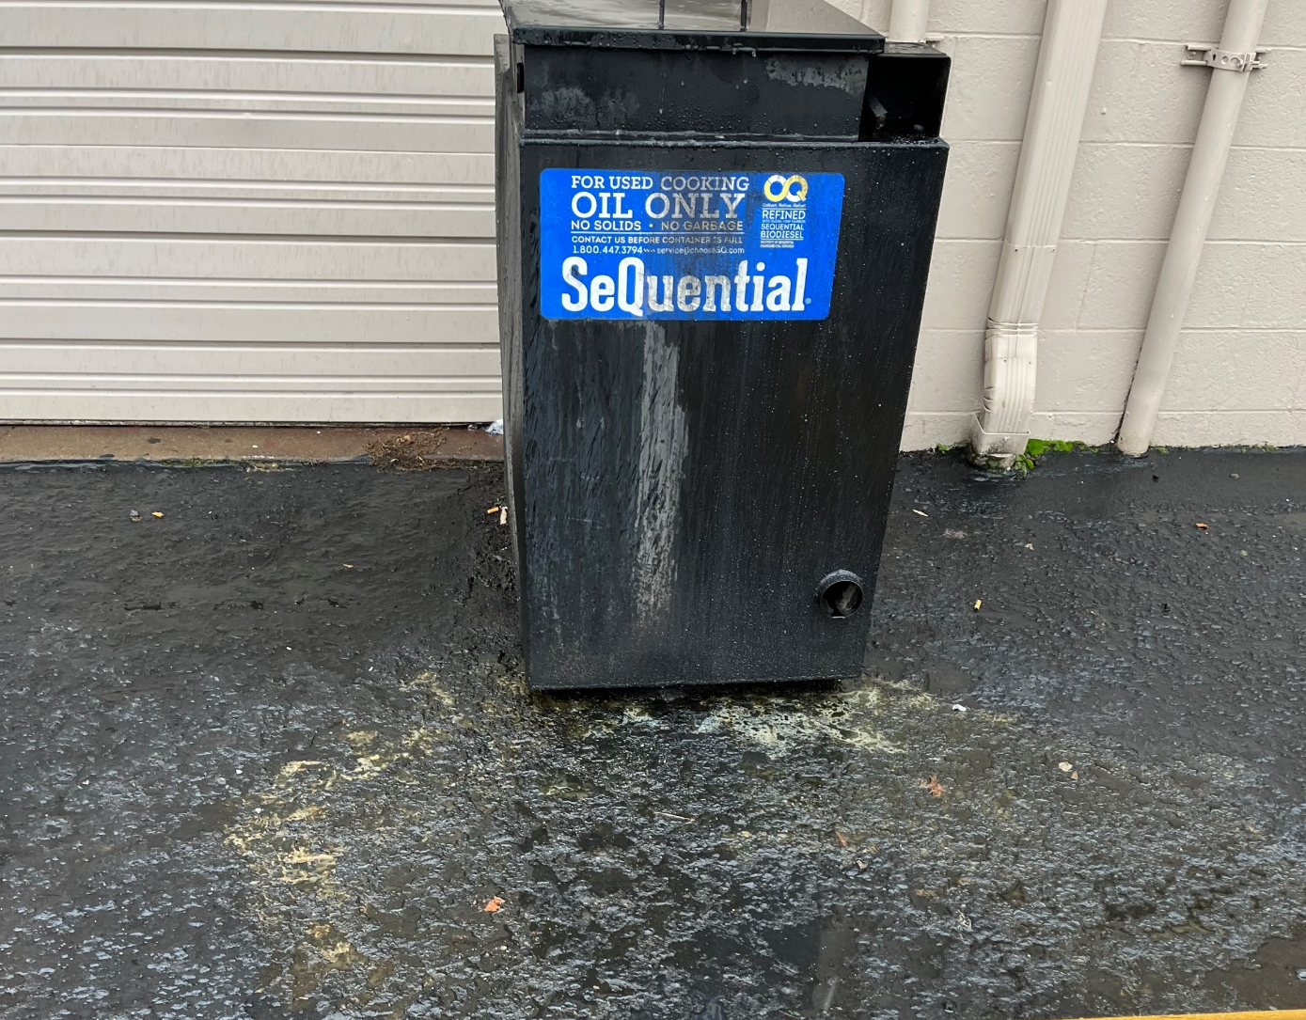
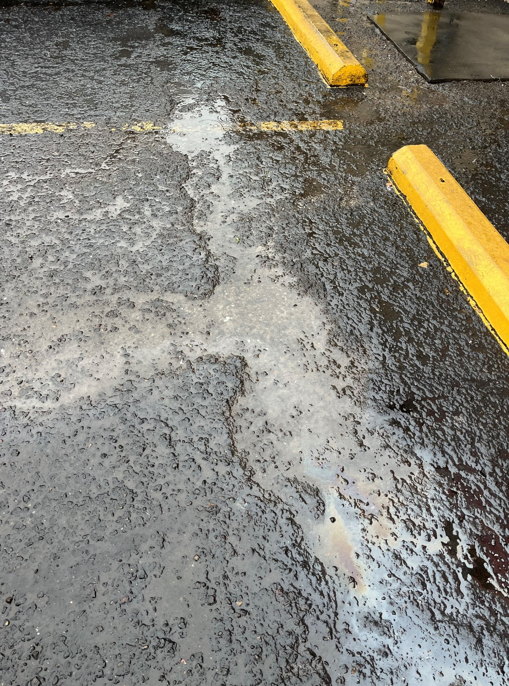

Why One Water in the FOG Program?
Notes:
It is all about Water Quality!
Commercial / Industrial by-products, like FOG, are regulated by the Pretreatment FOG Program.
Illicit stormwater discharges happen due to failure to follow Pretreatment Program rules, regulations and best management practices.

Slide 22
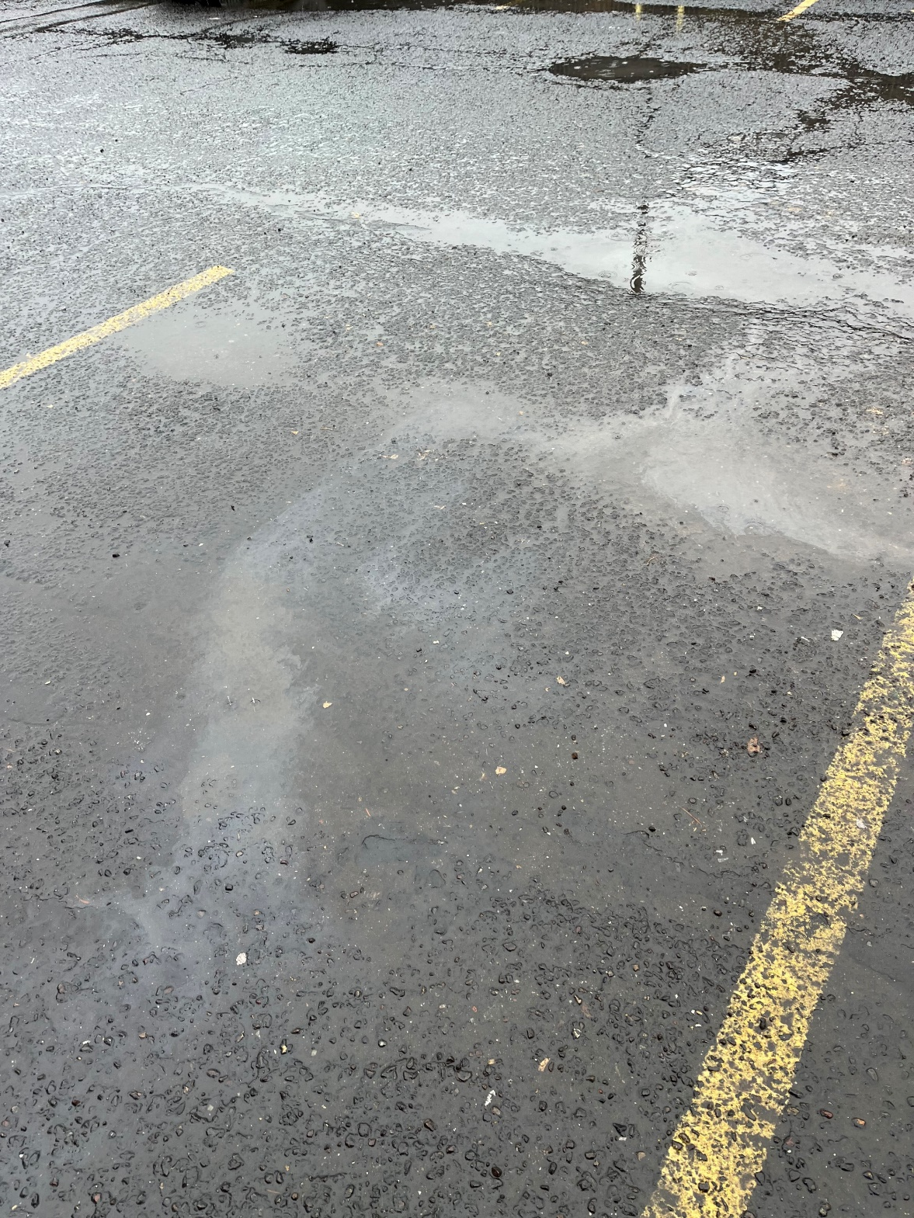
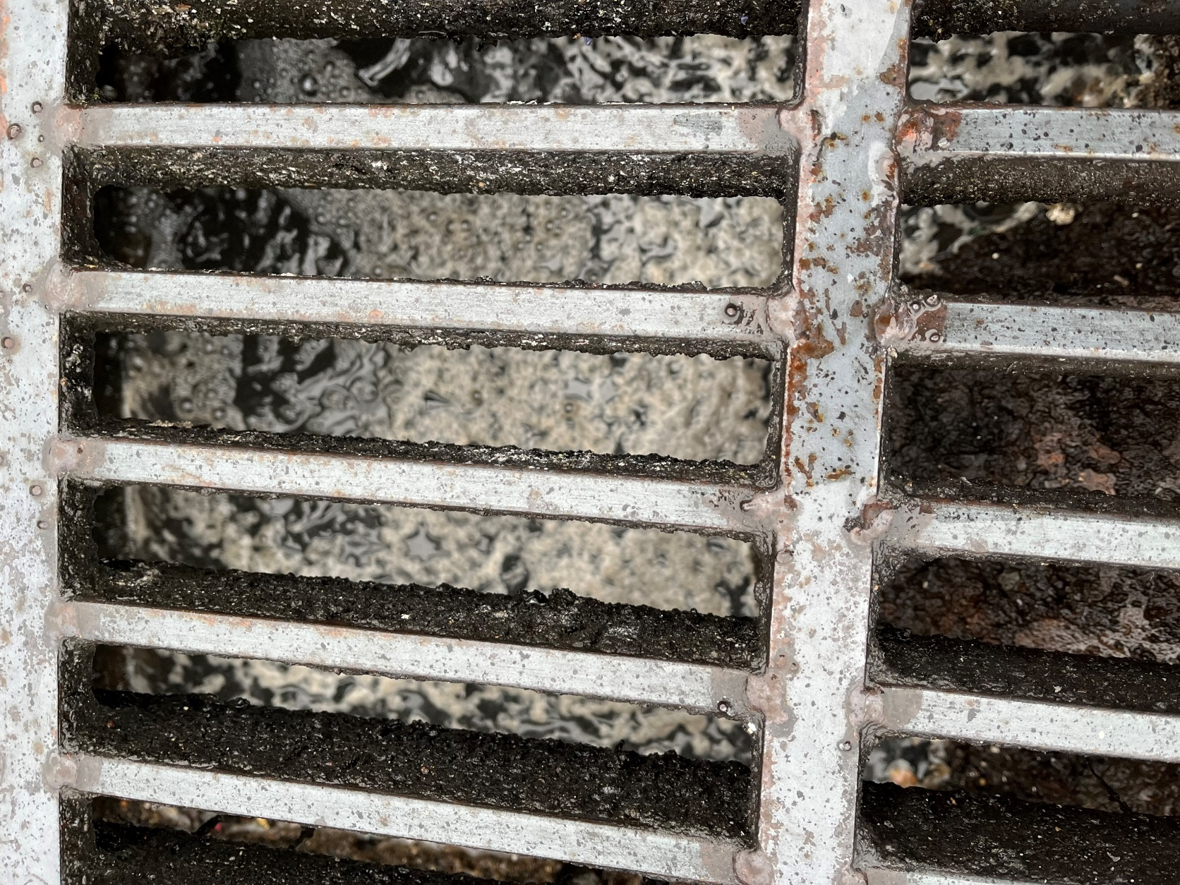
Notes:
Eugene does not have a combined SW/WW system so what goes down the storm drain goes into the river.

Slide 23
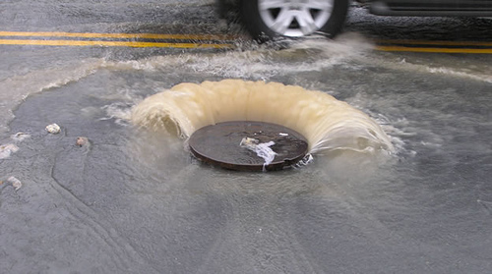
Questions???
Destin Ranch
Cell- 541-870-4001
Desk 541-682-8626
Email- Dranch@eugene-or.gov

