Slide 1
Understanding the basics of the Resource Conservation and Recovery Act
Hazardous Waste and Pretreatment
Ryan Peterson| Oregon Department of Environmental Quality

Slide 2
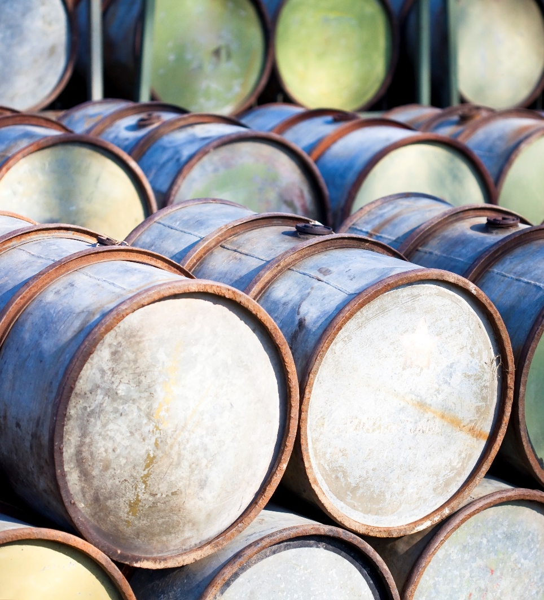
RCRA: Resource Conservation and Recovery Act
Enacted in 1976 - “cradle to grave” responsibilities on generators
Amended in 1984 to include smaller generators
Designed to protect environment, encourage prevention and recovery
Set standards for landfills and recycling facilities

Slide 3
RCRA Solid Waste
Discarded
Abandoned
Considered inherently waste-like
Disposed of
Burned
Incinerated
Recycled
EPA has three categories for a recycled material.
Used
Reused
Reclaimed
Certain dioxin-containing waste
Any solid, liquid, semi-solid sludge or contained gas that is…
40 CFR 261.2

Slide 4

All Hazardous Waste is Solid Waste
Solid Waste
Hazardous waste
Product

Slide 5
RCRA Exclusions and Exemptions
Solid Waste
Hazardous waste
Exemption
Exclusion

Slide 6




RCRA Solid Waste Exclusions
Domestic Sewage
Industrial waste discharges subject to the Clean Water Act
Secondary materials reclaimed and reused in the original process
Household hazardous waste
Excluded from RCRA

Slide 7




What is a Listed Waste?
F-listed
K-listed
U-listed
P-listed
Waste containing listed waste is a listed waste!
Most common F waste codes are F001 - F005 solvents
Spent from use as solvent
10% or greater total before-use concentration
F001 and F002 contain specific chlorinated solvents
F003 contains specific ignitable solvents
F005 contains specific toxic solvents

Slide 8
K-listed
U-listed
P-listed
F-listed
Most common F waste codes are F001 - F005 solvents
Spent from use as solvent
10% or greater total before-use concentration
F001 and F002 contain specific chlorinated solvents
F003 contains specific ignitable solvents
F005 contains specific toxic solvents
5% carbon tetrachloride (F001)
2% methylene chloride (F002)
5% toluene (F005)
+ 85% others
12% total listed solvent constituents
This spent solvent carries the waste codes F001, F002 & F005 listed

Slide 9
U-listed
P-listed
K-listed
Wastes from specific sources – including specific processes and/or process units.
K-listed hazardous waste fit within one of 13 K-list industries.
Identified in 40 CFR 261.32.
Toxic – kill you later
Discarded unused commercial chemical or sole active ingredient
Acutely toxic – kill you now
Discarded unused commercial chemical or sole active ingredient

Slide 10
U-listed
Toxic – kill you later
Discarded unused commercial chemical or sole active ingredient
P-listed
Acutely toxic – kill you now
Discarded unused commercial chemical or sole active ingredient
K-listed
Wastes from specific sources – including specific processes and/or process units.
K-listed hazardous waste fit within one of 13 K-list industries.
Identified in 40 CFR 261.32.

Slide 11




Characteristic Waste
Ignitable – D001
Ignitable
Corrosive
Reactive
Toxic

Slide 12


Corrosive – D002
Ignitable – D001
Waste liquid with a flashpoint <140°F
A waste solid or gas and that is capable, under standard temperature and pressure, of causing fire through friction, absorption of moisture, or chemical changes and, when ignited, creates a hazard.
Some oxidizers
Waste liquid with pH ≤ 2 or ≥12.5
  Lime Juice is pH 2.5 (acid)
  Cement is ~ pH 11(base)
Waste liquid that corrodes steel at a rate of >1/4”/year
Examples: ferric chloride,
concentrated chlorine,
HF acid
Ignitable
Corrosive
Reactive
Toxic

Slide 13
Corrosive – D002
Reactive – D003
Waste liquid with pH ≤ 2 or ≥12.5
  Lime Juice is pH 2.5 (acid)
  Cement is ~ pH 11(base)
Waste liquid that corrodes steel at a rate of >1/4”/year
Examples: ferric chloride, concentrated chlorine, HF acid
Waste material reactive to water, shock, heat or pressure, and undergoes a rapid, violent chemical reaction, or generates toxic gases.
Examples: Perchlorates, Cyanides and sulfides, Lithium, Zinc Powder and Trinitrotoluene
Corrosive
Ignitable
Reactive
Toxic

Slide 14

Reactive – D003
Waste material reactive to water, shock, heat or pressure, and undergoes a rapid, violent chemical reaction, or generates toxic gases.
Examples: Perchlorates, Cyanides and sulfides, Lithium, Zinc Powder and Trinitrotoluene
Reactive
Ignitable
Corrosive
Toxic

Slide 15

Toxic – D004 to D043
Most common toxins found in superfund sites
8 heavy metals
10 pesticides
22 organic chemicals
Toxic
Ignitable
Corrosive
Reactive

Slide 16
What if I generate wastewater?
SQG?
VSQG?
LQG?

Slide 17

Let’s Take a Moment to Recalibrate Our Brains
RCRA uses EXEMPTIONS
“does not apply” means the exemption does not apply
  Therefore, RCRA rules may apply
“applies” means the exemption does apply
  Exempt from RCRA rules

Slide 18
Wastewater Treatment Unit Exemption
(1)
(2)
(3)
Meets the definition of tank or tank system in § 260.10 of this chapter.
Receives and treats or stores an influent wastewater that is a hazardous waste as defined in § 261.3 of this chapter, or that generates and accumulates a wastewater treatment sludge that is a hazardous waste as defined in § 261.3 of this chapter, or treats or stores a wastewater treatment sludge which is a hazardous waste as defined in § 261.3 of this Chapter; and
Is part of a wastewater treatment facility that is subject to regulation under either section 402 or 307(b) of the Clean Water Act; and
40 CFR § 260.10
Wastewater Treatment Unit means a device which:

Slide 19
Wastewater Treatment Unit Exemptions
Must be subject to regulation under the CWA
Must treat a hazardous waste
Must meet RCRA definitions of a tank or tank system
". . . the wastewater treatment unit exemption is intended to cover only tank systems that are part of a wastewater treatment facility that (1) produces a treated wastewater effluent which is discharged into surface waters or into a POTW sewer system and therefore is subject to the NPDES or pretreatment requirements of the Clean Water Act, or (2) produces no treated wastewater effluent as a direct result of such requirements."

Slide 20

Evaporation
RO12923
RO11840
Evaporation of water through mist or heat as part of a non-discharge is acceptable only to reduce volume of waste.
Generator must be confident that only water is being evaporated, and not other wastes
Any release of hazardous waste or hazardous waste constituents to the air or the environment is considered disposal, and requires a RCRA permit

Slide 21
Takeaways
Applies to units on site
Must be subject to CWA requirements
Must be managed on site in tanks
The unit is exempt from RCRA permitting requirements, the waste is still subject to RCRA
Residues and sludges are not covered by the exemptions, only treated wastewater

Slide 22

WWTU Exemption Applicability
Hazardous Waste Liquid
Aqueous Liquid
Non-Aqueous Liquid (oil) + Aqueous Liquid
Non-Aqueous Liquid (oil)
Concentrated Chemicals (Treatment Solution)
Substantially Water with only a few % chemicals
Non-Aqueous Phase Removed
Not Eligible for WWTU Exemption Subject to Subpart J
WWTU Exemption Eligible
Yes
Yes
No

Slide 23
What if I treat wastewater?
Part B
NPDES
POTW

Slide 24
Publicly Owned Treatment Works
If receiving treated wastewater:
  Operate under NPDES permit or Pretreatment agreement
If receiving hazardous waste:
  Operate under a RCRA permit
    Costly and time consuming
  Operate under “Permit by Rule
The intention is for units to be regulated under a single set of rules to limit confusion and overlap

Slide 25
POTW Permit by Rule: 40 CFR 270.60(c)
A POTW which accepts for treatment hazardous waste is considered to have a RCRA Permit By Rule if the following conditions are met:
(1) Has an NPDES permit;
(2) Complies with the conditions of that permit; and
(3) Complies with the following regulations:
(i) 40 CFR 264.11, Identification number;
(ii) 40 CFR 264.71, Use of manifest system;
(iii) 40 CFR 264.72, Manifest discrepancies;
(iv) 40 CFR 264.73(a) and (b)(1), Operating record;
(v) 40 CFR 264.75, Biennial report;
(vi) 40 CFR 264.76, Unmanifested waste report; and
(vii) For NPDES permits issued after November 8, 1984, 40 CFR 264.101.
(4) If the waste meets all Federal, State, and local pretreatment requirements which would be applicable to the waste if it were being discharged into the POTW through a sewer, pipe, or similar conveyance.
Example: If a trucked hazardous waste violates a pretreatment requirement, the POTW may be subject to RCRA liability and may need a permit

Slide 26
Introducing: The Resource Conservation and Recovery Act and the Clean Water Act’s Pretreatment Program
Pretreatment and Hazardous Waste
Nicole Morris| Oregon Department of Environmental Quality

Slide 27

Why Learn About Pretreatment and Hazardous Waste?
Scenario:
The year is 1988.
You are an enterprising young business on the cutting edge of technology
You install a state-of-the-art industrial wastewater reuse system
These are “Wastewater Treatment Units”
You think maybe, your innovation can save the company
  No RCRA Part B permits
  No Pretreatment permits
Ground Breaking?
Or Rule Breaking?
Watch on to learn more!
(This is a dramatization)

Slide 28

Pretreatment
Enacted in 1978 - controls pollutants sent to Publicly Owned Treatment Works (POTWs).
Amended in 2005 with the “Streamlining Rule”.
Designed to protect a POTW against pass-through and interference of pollutants.
May regulate anything which enters a Public Sewer System – except residential waste.

Slide 29
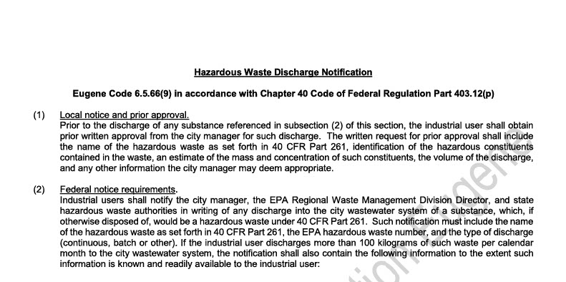
Pretreatment: RCRA Reporting Requirements
Industries discharging Hazardous Waste to a POTW must notify:
  POTW
  State Hazardous Waste Authorities
  EPA Regional Waste Management Division
40 CFR 403.12(p)

Slide 30



Pretreatment: RCRA Reporting Requirements
Amount of Hazardous Waste Generated
<15 kg/month IU not required to report, unless the wastes are acute hazardous wastes (P-listed waste)
15-100 kg/month IU required to report
>100 kg/month IU required to report and submit additional information within 180 days
By the way! This requirement can apply to hazardous wastes entering upstream of an industrial user’s pretreatment equipment! More on this later.
This is a simplification! Refer to 40 CFR 403.12(p).

Slide 31

Pretreatment: POTW as Treatment, Storage, and Disposal Facility
POTW acceptance of hazardous waste by truck, rail, or dedicated pipe (even unknowingly) is subject to the RCRA permit-by-rule requirements (TSDFs)
“the RCRA regulatory status of a waste is not necessarily straightforward” - EPA Local Limits Development Guidance 2004
Does NOT include received hazardous wastes mixed with domestic sewage (40 CFR 261.4(a)(1)) (discussed later)
40 CFR 403.12(p)
EPA Guidance Manual for the Identification of Hazardous Wastes Delivered to Publicly Owned Treatment Works by Truck, Rail, or Dedicated Pipe 1987
EPA Local Limits Development Guidance 2004

Slide 32
Pretreatment: Local Limits
Local Limits
WET (Whole Effluent Toxicity) test
15 pollutants of concern
Sludge use criteria or disposal requirements
NPDES or WPCF permit pollutants (including “monitor only”)
Any other pollutant
Arsenic, Cadmium, Chromium, Copper, Cyanide, Lead, Mercury, Nickel, Silver, Zinc, Molybdenum, Selenium, BOD, TSS, Ammonia
EPA Local Limits Development Guidance 2004

Slide 33

Pretreatment: Local Limits
Explosive and flammable substances, if present
Volatile organic compounds (VOCs), if present
CERCLA wastes
“EPA recommends that the POTW determine which [RCRA] pollutants are being discharged and should evaluate whether the pollutants ought to be considered POC”
Practically, this means the POTW must be able to treat the pollutant in question
EPA Local Limits Development Guidance 2004

Slide 34
Pretreatment: Sewerage Exclusion
RCRA wastes: “When mixed with domestic sewage in a POTW's collection system before reaching the boundary of the treatment works’ property, RCRA hazardous wastes are excluded from regulation under RCRA by the Domestic Sewage Exclusion, 40 CFR 261.4(a)(1).”
This exclusion applies to the POTW treatment, storage, and disposal
EPA Local Limits Development Guidance 2004
EPA Guidance for Implementing RCRA Permit-by-Rule Requirements at POTWs

Slide 35
Pretreatment: Sewerage Exclusion
40 CFR 261.4(a)(1) [the exclusion]
40 CFR 261.4(a)(1) does not apply to waste generated by the POTW*
40 CFR 261.4(a)(1) does not apply to wastes mixed with domestic sewage as part of the treatment process
40 CFR 261.4(a)(1) does not apply to non-POTWs**
Where 40 CFR 261.4(a)(1) applies, wastewater is subject to local limits
EPA Guidance for Implementing RCRA Permit-by-Rule Requirements at POTWs

Slide 36
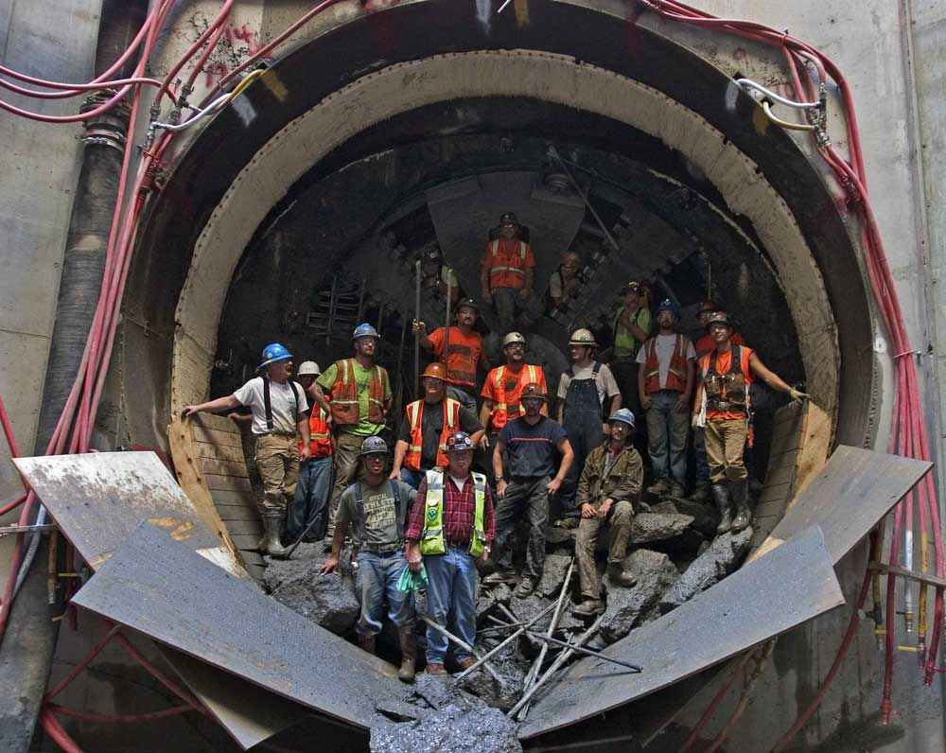
Pretreatment: Sewerage Exclusion & Wastewater Treatment Unit Exemption
Sewerage Exclusion: 40 CFR 261.4(a)(1) does not apply until after the waste enters the sewer system that will mix it with domestic sewage prior to reaching the POTW property boundary
So, what about before?
Wastewater Treatment Unit Exemption: 40 CFR § 260.10
Picture of City of Portland CFO Tunnel courtesy of https://cmtsllc.com/city-of-portland-cfo-tunnel/
EPA Guidance for Implementing RCRA Permit-by-Rule Requirements at POTWs

Slide 37
Pretreatment: Wastewater Treatment Unit Exemption
Wastewater Treatment Units (WWTUs) are exempt from RCRA requirements under 40 CFR § 260.10
Includes WWTUs at industries which may be regulated by POTWs
EPA intended not to “double-regulate”; therefore, typically, where a WWTU is “subject to” NPDES or Pretreatment regulations they would not be subject to RCRA regulations
Age-old questions:
What about when it’s unclear?
  Are non-dischargers “subject to”?
40 CFR § 260.10
January 16, 1992, letter from EPA to Mr. Thomas W. Cervino, P.E. Colonial Pipeline Company

Slide 38


Pretreatment: NDCIU/NSCIU/Zero Discharge
NDCIU – Non-Discharging Categorical Industrial User, State designation
NSCIU – Non-Significant Categorical Industrial User, Federal designation
Zero Discharge – Categorical Industrial User required by the category to not discharge, Federal designation

Slide 39

Pretreatment: NDCIU
NDCIU – Non-Discharging Categorical Industrial User, State designation
0 discharge of Categorical Wastewater
Potential to discharge*
Control Authority required to report on the Annual Pretreatment Report
Control Authority may use permit or letter to ensure continued compliance with non-discharging requirements (control mechanism)
Control Authority may inspect or require periodic certification statement to confirm non-discharge

Slide 40

Pretreatment: NSCIU
NSCIU – Non-Significant Categorical Industrial User, Federal designation
<100 gallons per day total categorical wastewater
Consistent compliance
Annual certification statement
Never discharge any untreated concentrated wastewater
Control Authority must report on Annual Pretreatment Report

Slide 41

Pretreatment: Zero Discharge
Zero Discharge – Categorical Industrial User required by the category to not discharge
Example: Wood Preserving 40 CFR 429.75 “…achieve the following pretreatment standards for new sources (PSNS): There shall be no introduction of process wastewater pollutants into publicly owned treatment works.”

Slide 42

Pretreatment: One or the Other
If a facility is unregulated by the NPDES program, it would be inappropriate to exempt them from RCRA regulation.
EPA determination, 1989
  NDCIU in Pennsylvania
  Industrial User contended that for not discharging:
    NPDES permit not required
    RCRA Part B permit not required
  EPA determined the absence of a NPDES permit or pretreatment standard specifying zero discharge (categorical requirement) necessitated a RCRA Part B permit
  Under this, NDCIU would not exempt a facility from a RCRA Part B permit
US EPA 1990 Letter to Mr. James C. Mulligan
US EPA 1989 Letter to Mr. Robert H. Elliott, Jr.

Slide 43
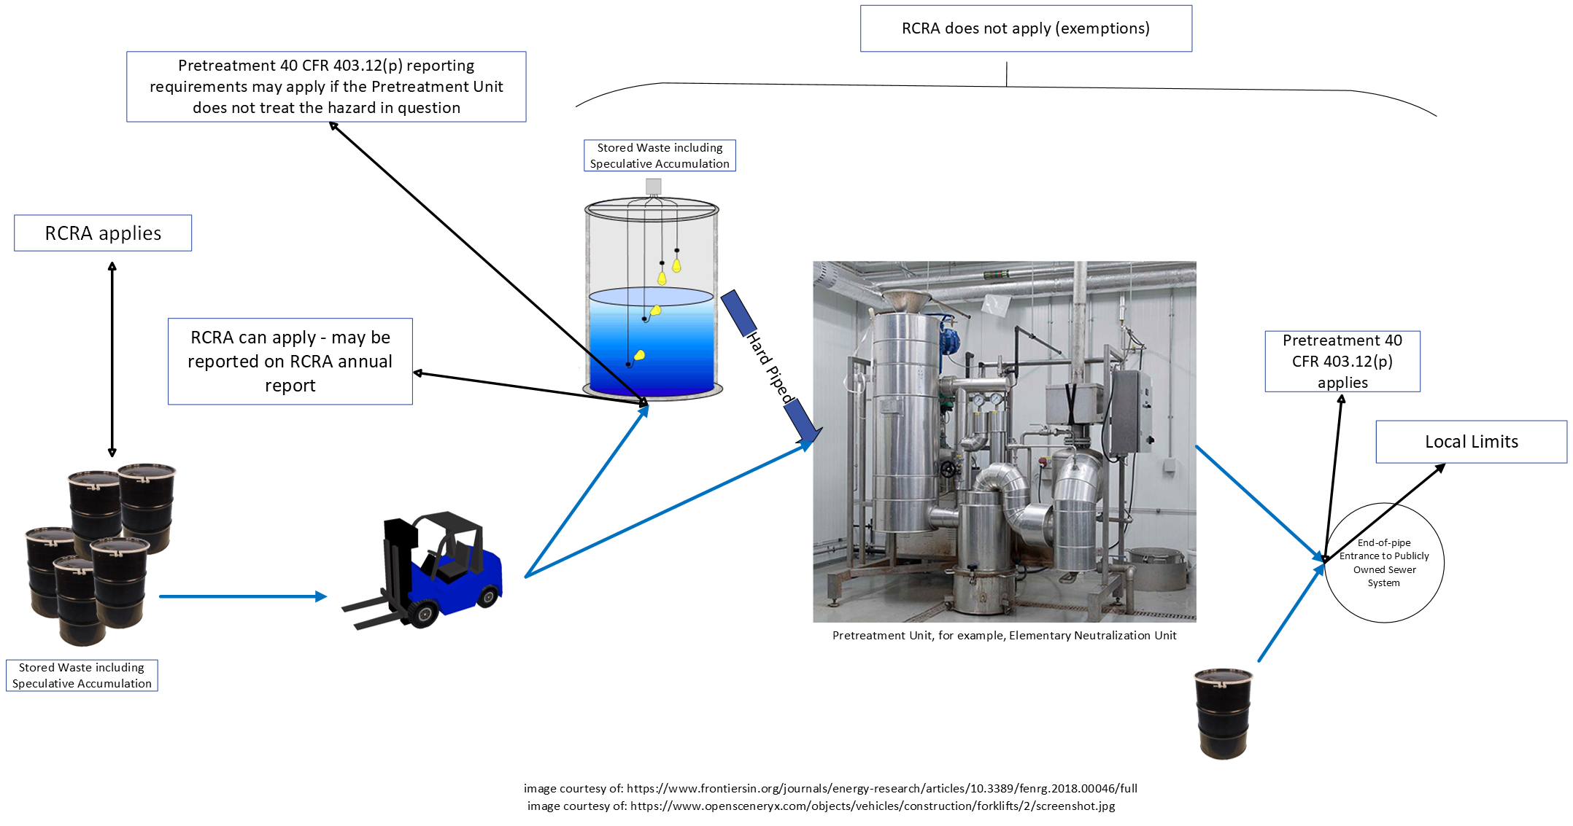
Basic Industrial Setup
This is a simplification! Refer to 40 CFR 403.12(p) and relevant RCRA rules.

Slide 44
Questions? Ask a regulator!
If you don’t know whether a POTW or an industry
Needs to report their hazardous waste
Meets (a) RCRA exemption(s)
Is an NDCIU, NSCIU, or Zero Discharger
Any other question
Ask your friendly neighborhood regulators!
Nicole Morris
Pretreatment Coordinator
700 NE Multnomah Street
Suite 600
Portland, Oregon 97232
Nicole.Morris@deq.Oregon.gov
971-282-7057
Ryan Peterson
Senior Hazardous Waste Policy Analyst
700 NE Multnomah Street
Suite 600
Portland, Oregon 97232
Ryan.Peterson@deq.Oregon.gov
503-475-1297

Slide 45
Title VI and alternative formats
DEQ does not discriminate on the basis of race, color, national origin, disability, age, sex, religion, sexual orientation, gender identity, or marital status in the administration of its programs and activities.
Visit DEQ’s Civil Rights and Environmental Justice page.
Español | 한국어 | 繁體中文 | Pусский | Tiếng Việt | العربية
Contact: 800-452-4011 | TTY: 711 | deqinfo@deq.state.or.us

