Slide 1



Perspectives on Policy & Pretreatment
2025 Pacific Northwest Pretreatment Workshop
National Association of Clean Water Agencies
October 13, 2025 | Vancouver, WA

Slide 2
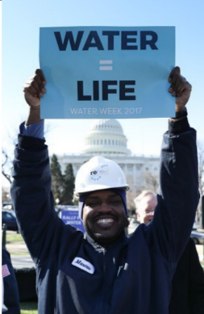

NACWA – A Clear Commitment
to Our Nation’s Waters
National trade association for public wastewater & stormwater utilities
Leader in legislative, regulatory and legal advocacy on the full spectrum of clean water issues
Represent over 350 public utilities of all sizes from around the country
National Association of Clean Water Agencies
Notes:
IP is just latest example of water as bipartisan effort in Congress
NACWA spearheaded efforts over 4 years to get this legislation passed into law – no one thought is could happen but we got it done!
Involved significant work, compromise, and coalition building to get passed into law, but is a significant victory for the public clean water utilities
Coalition lead by NACWA included USCM, NLC, NACo, APWA, WEF, and others
Issue now after passage is ensuring appropriate implementation, establishment of municipal ombudsman office.
NACWA requesting $2 million in FY 2020 appropriations to implement the legislation
Note that original legislation also included language requiring EPA to update its affordability guidance but this was stripped out during final negotiations. But EPA is moving forward with update to affordability guidance along lines suggested by NACWA/water sector and this will be discussed later in presentation.

Slide 3
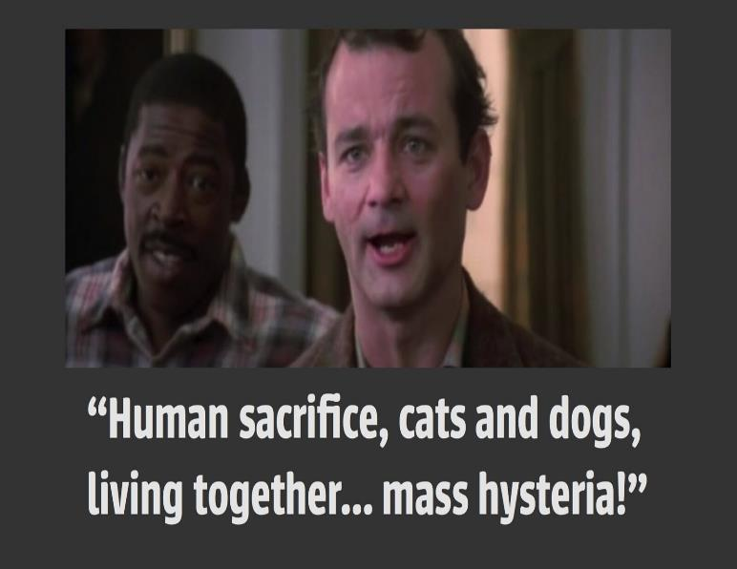
2025 So Far…
Federal Funding? Maybe
PFAS Regulations?
Who Knows
De-regulation? Probably
Legal Precedents Holding?
Probably Not
Lawsuits Over Everything? Yes!
National Association of Clean Water Agencies

Slide 4

What’s Happening at EPA?
Staffing Changes
Significant staffing cuts through terminations and buyouts
Jessica Kramer confirmed as Assistant Administrator (AA) for Water on September 18
New EPA team moving in a deregulatory direction – supposedly
Agency Reorganization
Office of Research and Development to be eliminated
Under Office of Water, Office of Science and Technology eliminated, new Office of Cybersecurity and Resiliency added
National Association of Clean Water Agencies

Slide 5
PFAS Maximum Contaminant Limits (MCLs)
“EPA intends to provide regulatory flexibility and holistically address these contaminants in drinking water”
  Final rule published April 10, 2024:
    PFOA and PFOS – 4 ppt
    PFHxS, PFNA, GenX – 10 ppt
    Mixtures of PFHxS, PFNA, GenX, PFBS
  EPA announcement on May 14, 2025:
    Compliance for PFOA and PFOS delayed from 2029 to 2031
    Intent to rescind other PFAS MCLs (asked DC Circuit to vacate these regulations on Sept.11)
  “Combined with effluent limitations guidelines for PFAS and other tools to ensure that polluters are held responsible, EPA’s actions are designed to reduce the burden on drinking water systems…”
National Association of Clean Water Agencies

Slide 6
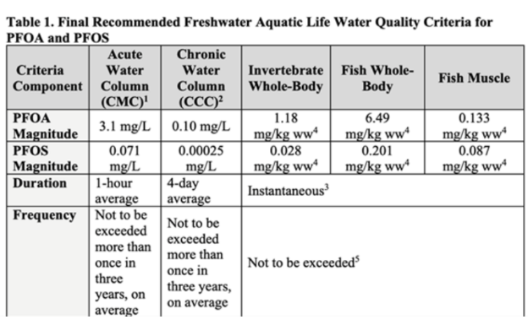
PFAS Aquatic Life Criteria
October 7, 2024 – EPA publishes final aquatic life criteria for PFOA and PFOS
Benchmarks set for eight other PFAS
EPA states that “the best available science indicates that PFAS levels in the environment appear to be significantly below levels that would affect aquatic life, except in areas where there is known contamination such as Superfund sites.”
National Association of Clean Water Agencies
Notes:
IP is just latest example of water as bipartisan effort in Congress
NACWA spearheaded efforts over 4 years to get this legislation passed into law – no one thought is could happen but we got it done!
Involved significant work, compromise, and coalition building to get passed into law, but is a significant victory for the public clean water utilities
Coalition lead by NACWA included USCM, NLC, NACo, APWA, WEF, and others
Issue now after passage is ensuring appropriate implementation, establishment of municipal ombudsman office.
NACWA requesting $2 million in FY 2020 appropriations to implement the legislation
Note that original legislation also included language requiring EPA to update its affordability guidance but this was stripped out during final negotiations. But EPA is moving forward with update to affordability guidance along lines suggested by NACWA/water sector and this will be discussed later in presentation.

Slide 7

PFAS Human Health Water Quality Criteria
  Proposed December 2024; Comment period ended April 25, 2025
  Incredibly low values:
    PFOA – 0.0009 ppt
    PFOS – 0.06 ppt
    PFBS – 400 ppt
  Values dependent on problematic reference doses and cancer slope factors established in National Primary Drinking Water Regulations/MCLs
  NACWA comments outlined concerns with underlying science as well as failure to consider technical feasibility and costs
National Association of Clean Water Agencies

Slide 8
CERCLA Hazardous Substance Designation
Comprehensive Environmental Response, Compensation, and Liability Act (CERCLA)
September 2022 – EPA proposes to designate PFOA and PFOS as “hazardous substances” under Section 102(a) of CERCLA
May 8, 2024 – EPA published final rule, which was effective July 8, 2024
First time EPA has used this authority to designate hazardous substances without those substances first being designated as hazardous or toxic under the primary federal air, water, or toxics statutes
Two goals of CERCLA, according to Congress:
Provide for clean-up if a hazardous substance is released into the environment
Hold responsible parties liable for the costs of these clean-ups
National Association of Clean Water Agencies

Slide 9
CERCLA Liability for POTWs
CERCLA assigns strict, retroactive, joint, and several liability to potentially responsible parties (PRPs)
POTWs did not need to know they were “disposing” of PFAS via effluent or biosolids to be held liable
Liability under CERCLA applies even if past practices were lawful and directed, permitted, or known by state or federal government
Even if a POTW is only responsible for a fraction of PFAS contamination, it can be liable for cleaning up an entire site, particularly if other PRPs cannot be identified
POTWs can be brought in as PRPs by third parties
National Association of Clean Water Agencies
Notes:
-

Slide 10
Examples of CERCLA Liability for POTWs
Passaic Valley, NJ cleanup of dioxins
  OxyChem has brought multiple downstream POTWs into its own CERCLA lawsuit to make them pay for part of cleanup
  EPA has tried to limit POTW responsibility, but utilities have spent hundreds of thousands of dollars on litigation costs alone
Fox River, WI cleanup of PCBs
  Local utilities implicated in contamination and proving de minimis contribution has significant costs
National Association of Clean Water Agencies
Notes:
-

Slide 11
EPA CERCLA Enforcement Discretion Memo
“EPA does not intend to pursue entities where equitable factors do not support seeking response actions or costs under CERCLA, including, but not limited to, community water systems and publicly owned treatment works, municipal separate storm sewer systems, publicly owned/operated municipal solid waste landfills, publicly owned airports and local fire departments, and farms where biosolids are applied to the land.
“For these same parties, EPA can use CERCLA statutory authorities when appropriate to enter into settlements that provide contribution protection from third party claims for matters addressed in the settlement.”
National Association of Clean Water Agencies

Slide 12
EPA to Defend PFAS CERCLA Designation
September 17, 2025, court filing and announcement by EPA that it will defend PFAS CERCLA designation in U.S. Chamber of Commerce v. EPA
Stated that the Agency must also continue to work to establish “a clear liability framework that ensures the polluter pays and passive receivers are protected.”
The Agency for the first time expressly acknowledged that, while “EPA intends to do what it can based on its existing statutory authority,” it “will need new statutory language from Congress to fully address the concerns with passive receiver liability.”
According to Administrator Zeldin, the Agency is taking this position after “hearing loud and clear from the American people, from Congress, and from local municipalities.”
National Association of Clean Water Agencies

Slide 13
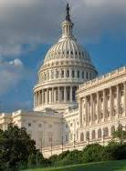
Water Systems PFAS Liability Protection Act
HR 1267, 23 current co-sponsors (14 Republicans, 9 Democrats)
Provides a targeted exemption for water sector utilities from CERCLA liability for PFAS
Supported by the Water Coalition Against PFAS
National Association of Clean Water Agencies
Notes:
-Goal of this slide is to emphasize 1.) NACWA has worked hard, and been successful, in elevating water as a national priority. Fact that water was on par with other infra sectors in Trump and Dem congressional infra plans is BIG DEAL, even if the plans didn’t go anywhere.
-But also to emphasize that water is bipartisan issue and this is demonstrated by success we have made over the years through increasing funding and past WRDA bills. But water is considered bipartisan issue in larger part only b/c of work done by NACWA, its members, and the broader clean water sector to emphasize it as such.

Slide 14

Draft Sewage Sludge Risk Assessment
Released at end of Biden Administration
Estimated risk of 1 ppb PFOA or PFOS to an atypical “farm family” – not general population – for biosolids disposal methods: land application, surface disposal and incineration (qualitative analysis only)
Found elevated risk for both cancer and non-cancer health effects. Examples:
  1 x 10⁻³ cancer risk for milk consumption in pasture farm scenario
  1 x 10⁻⁴ cancer risk for drinking water and fish consumption for food crop farm scenario
National Association of Clean Water Agencies

Slide 15
Concerns with Draft Sewage Sludge Risk Assessment
Compounded conservative with risk assessment framework
  EPA’s own Science Advisory Board stated that the assumptions used by EPA are “well outside the norm of present-day family farms . . . the vast majority of biosolids applications are made to lands that are not used for producing food directly consumed by humans but rather to lands used for producing animal feed, fiber and/or fuel.”
No consideration of relative or comparative risks
Problematic underlying data and assumptions
National Association of Clean Water Agencies

Slide 16
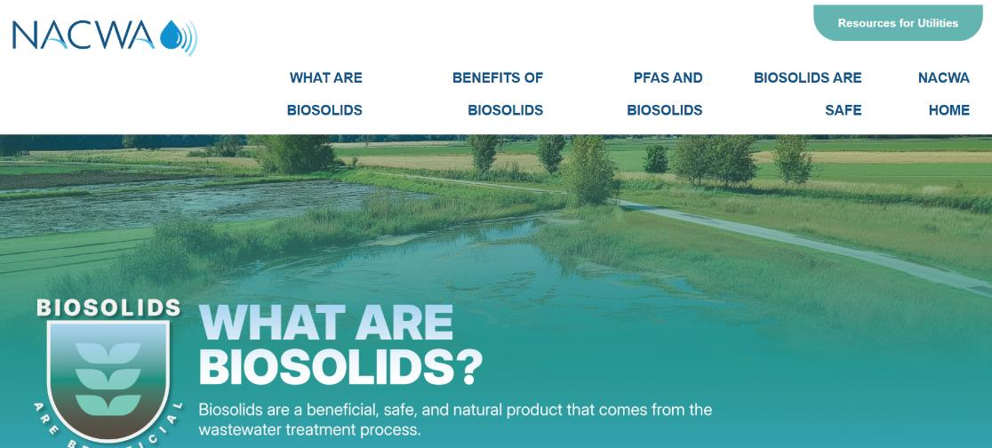
Biosolids Rescources: biosolidsexplained.org
Biosolids
National Association of Clean Water Agencies

Slide 17
Draft Sewage Sludge Risk Assessment
Pretreatment Statement in Federal Register
“Regardless of the management practice to use or dispose of sewage sludge, exposure and risk reduction is possible through pretreatment at industrial facilities discharging to a WWTP [wastewater treatment plant]. By monitoring sewage sludge for PFOA and PFOS, WWTPs can identify likely discharges of PFOA and PFOS from industrial contributors, require pretreatment, and achieve significant reductions in PFOA and PFOS concentrations in their sewage sludge. In some state programs, WWTPs with industrial sources have achieved a 98 percent reduction in PFOS sewage sludge concentrations through industrial pretreatment initiatives. The EPA recommends that states, Tribes, and WWTPs monitor sewage sludge for PFAS contamination, identify likely industrial discharges of PFAS, and implement industrial pretreatment requirements, where appropriate. Doing so will help reduce downstream PFAS contamination and lower the concentration of PFOA and PFOS in sewage sludge.”
National Association of Clean Water Agencies

Slide 18
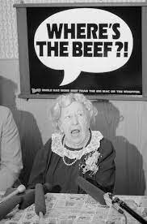
PFAS Effluent Guidelines & Pretreatment Standards
  Organic Chemicals, Plastics, and Synthetic Fibers (OCPSF) Effluent Guidelines
    Proposed rule withdrawn from White House Office of Management & Budget (OMB) on January 21, 2025
  EPA Preliminary ELG Plan 16, December 2024
    OCPSF – Fall 2024
    Metal Finishing – Spring 2026
    Landfills – 2027
National Association of Clean Water Agencies

Slide 19
Proposed ICR – March 26, 2024
Questionnaire for 400 largest POTWs to complete, under Clean Water Act Section 308
From the questionnaire information, EPA will ask 200 POTWs to sample up to 10 upstream industrial users, plus samples from influent, effluent, and domestic sources, at utility’s expense
Biosolids sampling will occur later
Questionnaire originally scheduled to go out January 2025
EPA POTW PFAS Influent Study and
National Sewage Sludge Survey
National Association of Clean Water Agencies

Slide 20
NACWA Comments
EPA should compile all available data for PFAS before requiring additional sampling
Utilize TRI data that is required for PFAS
Any data gaps could be targeted with a well-designed study, rather than a broad, one-time sampling event that is unlikely to yield actionable data on PFAS
Costs and laboratory capacity should be considered
Methods 1621 and 1633 should not both be required
Biosolids sampling should be separated from POTW Influent Study
EPA POTW PFAS Influent Study and
National Sewage Sludge Survey
National Association of Clean Water Agencies

Slide 21
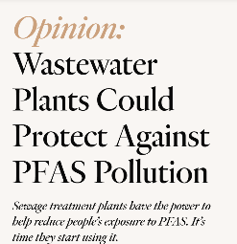
Control PFAS with Local Limits??
Southern Environmental Law Center on Undark
  PFAS “are insidious and harmful, and local U.S. wastewater utilities are likely giving them a free ride into drinking water and food.”
  “As it stands, many wastewater plants are irresponsibly discharging the PFAS they receive from their industrial customers back into our drinking water sources.”
  “We cannot afford to wait for thousands of PFAS to be regulated individually, or to play whack-a-mole with each type of PFAS-polluting industry. The time is now to use pretreatment authority to hold polluters accountable.”
National Association of Clean Water Agencies

Slide 22

Control PFAS with Local Limits??
  “Wastewater plants are paid on the front end to accept industrial wastewater and on the back end for selling sludge, with some multistate utilities bringing in hundreds of millions of dollars each year. Total U.S. wastewater treatment revenue amounted to $65.3 billion in 2019. The very least these public utilities can do is use their pretreatment authority to prevent PFAS pollution from reaching our drinking water and food.”
National Association of Clean Water Agencies

Slide 23
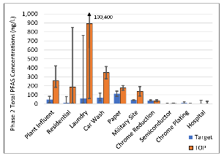
Bay Area Clean Water Agencies (BACWA) Study
  “At most Bay Area treatment plants, more than 95% of flows are from residential and commercial customers. Phase 2 results indicate that residential areas may contribute PFAS at concentrations similar to plant influent, which means that residential users may be the dominant source of PFAS to many treatment facilities. . . This source of PFAS can only be controlled by removing or reducing the amount of PFAS found in consumer products.” (Study summary)
National Association of Clean Water Agencies

Slide 24
MEAT & POULTRY PRODUCTS (MPP) –
Proposed ELGs & Pretreatment Standards
January 23, 2024 – EPA proposed effluent limitation guidelines (ELGs) and pretreatment standards for BOD, TSS, and oil & grease
Currently no pretreatment standards for MPP Category
EPA suggested that “POTWs that perform denitrification may want to waive BOD limits for their MPP industrial users so they can receive more carbon…”
EPA presented options for nutrient pretreatment standards, but not as the preferred option
National Association of Clean Water Agencies
Notes:
-

Slide 25
Pretreatment standards are not necessary for conventional pollutants – they are not inherently harmful to the treatment process and should not pass through it, since POTWs are designed to treat conventional pollutants
Local control is more appropriate, since POTWs best understand the capacity and processes of the treatment plant
POTWs often need the BOD for their treatment processes and the revenue for treating BOD
Waiver process would introduce unneeded complication
NACWA Asked for Local Control of MPP Discharges to Continue
National Association of Clean Water Agencies

Slide 26
EPA Withdraws Proposal for ELGs and Pretreatment Standards for MPP Category
EPA announced on August 30, 2026, that it would withdraw proposal, citing information in public comments and the Administration’s priorities of “protecting food supply and mitigating inflationary prices for American consumers.”
Ten environmental groups filed a lawsuit on September 15, 2025, challenging EPA’s decision
National Association of Clean Water Agencies

Slide 27


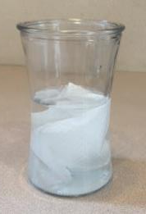
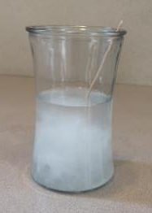
Toilets Are Not Trashcans!
Protecting our Pipes, Pumps, Plants, & Personnel
Flushable products that are safe for sewer systems
Clear labeling of non-flushable products
Consumer education
National Association of Clean Water Agencies
Notes:
IP is just latest example of water as bipartisan effort in Congress
NACWA spearheaded efforts over 4 years to get this legislation passed into law – no one thought is could happen but we got it done!
Involved significant work, compromise, and coalition building to get passed into law, but is a significant victory for the public clean water utilities
Coalition lead by NACWA included USCM, NLC, NACo, APWA, WEF, and others
Issue now after passage is ensuring appropriate implementation, establishment of municipal ombudsman office.
NACWA requesting $2 million in FY 2020 appropriations to implement the legislation
Note that original legislation also included language requiring EPA to update its affordability guidance but this was stripped out during final negotiations. But EPA is moving forward with update to affordability guidance along lines suggested by NACWA/water sector and this will be discussed later in presentation.

Slide 28
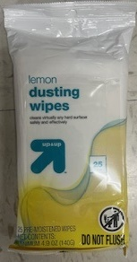
Wastewater Infrastructure Pollution Prevention and Environmental Safety (WIPPES)
  Sets federal “Do Not Flush” labeling standards for non-flushable wipes and provides a consistent national labeling landscape.
  Closely modeled after state laws and would preempt state wipes labeling laws
  Bipartisan and Bicameral Introductions
    S. 1092: Sen. Jeff Merkley (D-OR); Sen. Susan Collins (R-ME)
    H.R. 2269: Rep. Lisa McClain (R-MI); Rep. Kevin Mullin (D-CA)
  Supported by NACWA, WEF, CASA, and the Association of the Nonwoven Fabrics Industry (INDA)
  H.R. 2269 passed on June 23, 2025
National Association of Clean Water Agencies

Slide 29
U.S., Canada, Australia, New Zealand, Japan, and Spain
IWSFG flushability specifications published in 2018, updated in 2020
www.iwsfg.org
INTERNATIONAL WATER SERVICES FLUSHABILITY GROUP
(IWSFG)
The National Association of Clean Water Agencies

Slide 30
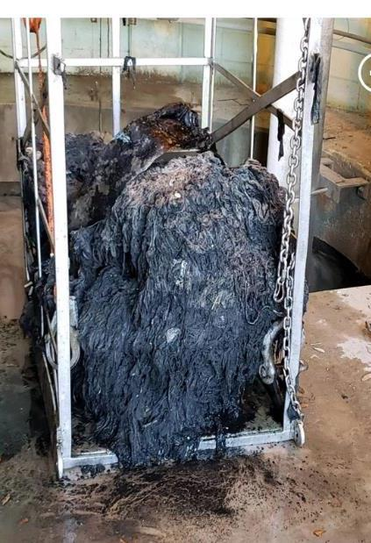
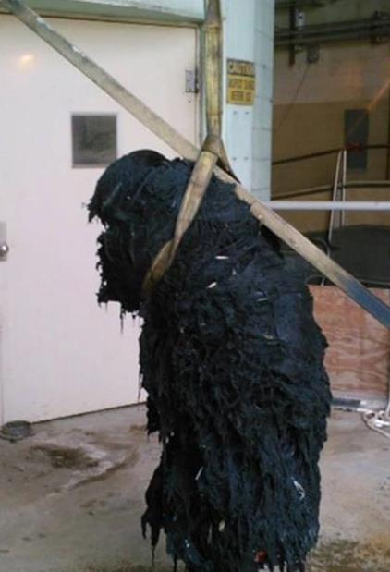
CHARLESTON, SC
“Workers take dive into deep doo to unclog sewer pumps”
“Divers swim through 90 feet of raw sewage to unclog giant, hairy ‘fatberg’”
National Association of Clean Water Agencies

Slide 31
Lawsuit against Costco, CVS, Kimberly-Clark, Procter & Gamble, Target, Walgreens, and WalMart
Settlement agreement with Kimberly-Clark:
  KC Flushable wipes will meet IWSFG specifications by May 2022
  Non-flushable wipes will be properly labeled
Other companies also entered similar settlement agreements
CHARLESTON WATER SYSTEM CLASS ACTION LAWSUIT
National Association of Clean Water Agencies
Notes:
-

Slide 32
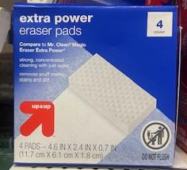
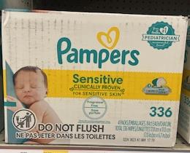
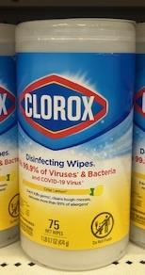

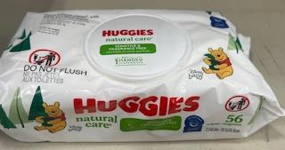
Do Not Flush Labeling Compliance
National Association of Clean Water Agencies
Notes:
IP is just latest example of water as bipartisan effort in Congress
NACWA spearheaded efforts over 4 years to get this legislation passed into law – no one thought is could happen but we got it done!
Involved significant work, compromise, and coalition building to get passed into law, but is a significant victory for the public clean water utilities
Coalition lead by NACWA included USCM, NLC, NACo, APWA, WEF, and others
Issue now after passage is ensuring appropriate implementation, establishment of municipal ombudsman office.
NACWA requesting $2 million in FY 2020 appropriations to implement the legislation
Note that original legislation also included language requiring EPA to update its affordability guidance but this was stripped out during final negotiations. But EPA is moving forward with update to affordability guidance along lines suggested by NACWA/water sector and this will be discussed later in presentation.

Slide 33
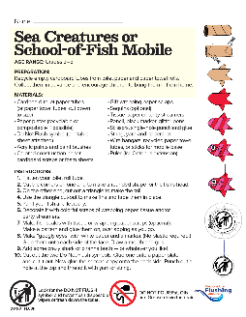
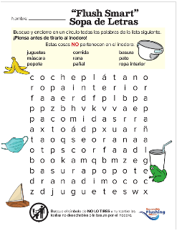
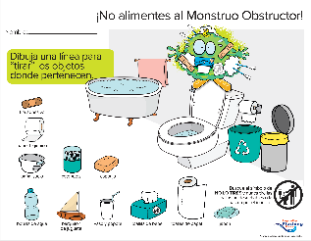
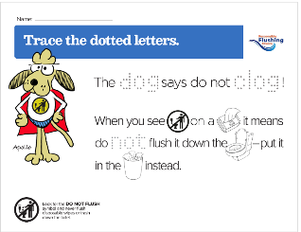
Educational Materials
from the Responsible Flushing Alliance
www.flushsmart.org
National Association of Clean Water Agencies
Notes:
IP is just latest example of water as bipartisan effort in Congress
NACWA spearheaded efforts over 4 years to get this legislation passed into law – no one thought is could happen but we got it done!
Involved significant work, compromise, and coalition building to get passed into law, but is a significant victory for the public clean water utilities
Coalition lead by NACWA included USCM, NLC, NACo, APWA, WEF, and others
Issue now after passage is ensuring appropriate implementation, establishment of municipal ombudsman office.
NACWA requesting $2 million in FY 2020 appropriations to implement the legislation
Note that original legislation also included language requiring EPA to update its affordability guidance but this was stripped out during final negotiations. But EPA is moving forward with update to affordability guidance along lines suggested by NACWA/water sector and this will be discussed later in presentation.

Slide 34

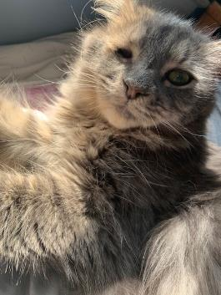

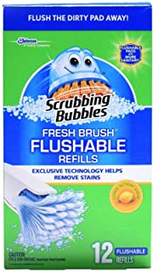
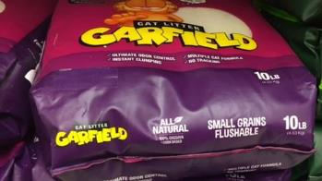
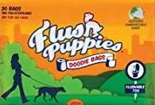
Wipes: The Tip of the Fatberg
National Association of Clean Water Agencies
Notes:
IP is just latest example of water as bipartisan effort in Congress
NACWA spearheaded efforts over 4 years to get this legislation passed into law – no one thought is could happen but we got it done!
Involved significant work, compromise, and coalition building to get passed into law, but is a significant victory for the public clean water utilities
Coalition lead by NACWA included USCM, NLC, NACo, APWA, WEF, and others
Issue now after passage is ensuring appropriate implementation, establishment of municipal ombudsman office.
NACWA requesting $2 million in FY 2020 appropriations to implement the legislation
Note that original legislation also included language requiring EPA to update its affordability guidance but this was stripped out during final negotiations. But EPA is moving forward with update to affordability guidance along lines suggested by NACWA/water sector and this will be discussed later in presentation.

Slide 35
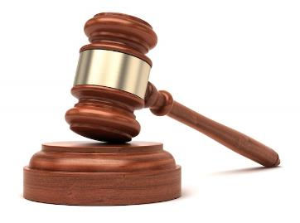
Conservative Law Foundation v. MWRA
Catching Up on a Little Good Case Law
  Feb. 2023 decision from the U.S. District Court for the District of Massachusetts
  Background: ENGO Conservative Law Foundation brought suit arguing that MWRA was in violation of its NPDES permit because it failed to take sufficient enforcement action against industrial users.
  Issue: Do citizens have a right to bring lawsuits over a utility's administration of its pretreatment program?
  Decision: CWA section 309(f) only provides EPA – not outside groups – with the right to oversee administration of a pretreatment program.
National Association of Clean Water Agencies

Slide 36
Conservative Law Foundation v. MWRA
  Helpful dicta: Court pointed to several policy arguments in favor of MWRA -
    Allowing ENGOs to second-guess EPA assessment of pretreatment programs could lead to flood of litigation;
    Utilities would face inconsistent requirements and be "in the dark in implementing their own" programs;
    Citizen groups lack engineering and systems expertise to ensure costs imposed will not outweigh benefits achieved;
    EPA is answerable to the public, ENGOs are "answerable only to their own members."
  Potential applications going forward: Could help combat ENGO positions about utility use of pretreatment programs in context of PFAS.
National Association of Clean Water Agencies

Slide 37
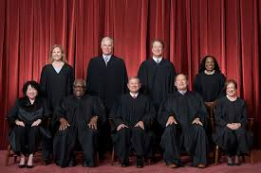
City and County of San Francisco v. EPA
San Francisco Supreme Court Decision
  Background: SFPUC challenged as overly vague requirements in its NPDES permit requiring it not to "create pollution" or "cause or contribute to the violation of water quality standards."
  Decision: Such "end result requirements" - i.e., requirements "that do not spell out what a permittee must do or refrain from doing" - are unlawful and are not needed to protect water quality.
  Court's Reasoning:
    Such provisions violate the text, structure, and history of the CWA
    Would allow for significant enforcement when permit holder never put on notice of compliance obligations
National Association of Clean Water Agencies

Slide 38
City and County of San Francisco v. EPA
  Court's Reasoning (continued):
    Eviscerate the section 402(k) "permit shield"
    Are problematic to implement where there are multiple dischargers to waterbody
  Potential Application to Pretreatment:
    Case does NOT directly implicate pretreatment program – Court's reasoning based on statutory provisions specific to NPDES permits and permit holders
    Case does NOT call into question narrative provisions like BMPs, record-keeping, testing, reporting
    Case does NOT call into question regulations/guidance using "end result" language, only directly enforceable terms in NPDES permits
    Arguably could be used to infer that utilities cannot enforce requirements against industrial users unless those requirements spell out compliance obligations
National Association of Clean Water Agencies

Slide 39

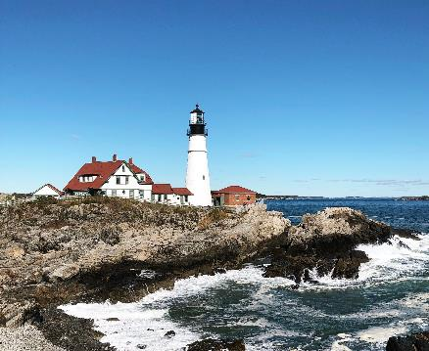
Upcoming Events
  2025 Pretreatment Virtual Workshop
  December 9-10, 1:00-5:00 pm ET
  2026 Pretreatment Workshop
  May 5-8, Portland, Maine
National Association of Clean Water Agencies

Slide 40

Questions?
Cynthia Finley
Director, Regulatory Affairs
cfinley@nacwa.org
www.nacwa.org
National Association of Clean Water Agencies
October 13. 2025 | Vancouver, WA

